Slide 1

Year One
Welcome Meeting

Slide 2
Year 1 – Elm Class
• Spelling – words will be sent home each Tuesday
Please help your child practise these.
• Phonics – an activity will be sent home each Friday. The activity will focus on the week’s learning.
• P.E – PE days are Wednesday and Thursday
• Reading – your child will read their home reading book at least once a week in school. Please read each day at home to help your child’s confidence, fluency and understanding. Please send their reading book into school each day.
Outdoor Learning - This will take place over two half terms this year.
Library – we will visit the library each Monday. Enjoy sharing
the book and please return the following Monday.

Slide 3
What changes in Year 1?
• Year 1 builds on the learning and independence developed in Reception.
• Children are encouraged to become confident, independent learners.
• There is a strong focus on reading, phonics, writing, number and problem-solving.
• Learning is still practical, active and creative.
In Year 1, children begin to experience a wider range of subjects as part of the National Curriculum, including History, Geography, Religious Education, Art, Design and Technology (DT), Computing and Learning for Life, providing more opportunities to develop specific knowledge and skills across different areas of learning. This is a progression from the EYFS, where learning is organised mainly through the seven areas of learning and development.

Slide 4
Writing
• Write sentences that can be read by others.
• Use capital letters, full stops and spaces between words accurately.
• Use phonics knowledge to spell words and learn common exception words.
• Write for different purposes: stories, recounts, descriptions, labels, instructions and simple information texts.
• Use orally rehearse ideas before writing.
• Begin to improve writing by rereading, checking and making simple corrections.

Slide 5
Handwriting and Spelling
Develop clear, correctly formed pre-cursive letters and increasingly consistent letter size using a tripod grip.
• Write with increasing fluency and stamina.
• Apply phonics when spelling unfamiliar words.
Spell Year 1 statutory word list.
Words connected to our phonics lessons will be sent home weekly. Please help your child to practise these.

Slide 6
Maths
• Count to and across 100, forwards and backwards, beginning from different numbers.
• Read and write numbers to 100 and understand place value.
• Count in 2s, 5s and 10s.
• Represent and use number bonds within 20.
• Add and subtract numbers within 20 and begin to work with numbers up to 100.
• Recognise, find and name common 2-D and 3-D shapes.
• Describe position, direction and movement.
• Compare, measure and begin to record length, height, weight, capacity and time.
Multiplication and Division

Slide 7
Phonics
• Phonics remains a key part of learning to read and spell.
• Children continue to practise grapheme–phoneme correspondences and blending for reading.
• They learn alternative spellings and pronunciations and apply these when reading and writing.
• Children practise reading common exception words.
• Regular practice helps children become increasingly automatic and fluent readers.

Slide 8
Phonics
Phonics is taught daily in school using Red Rose Phonics.
The children are taught to recognise the sounds that each individual letter makes; ▪identify the sounds that different combinations of letters make - such as ‘sh’ or ‘oo’; and blend these sounds together from left to right to make a word.
Children can then use this knowledge to ‘de-code’ new words that they hear or see.

Slide 9
Phonics in Year 1
Your child has been taught Phase 2, 3 and 4 in EYFS.
In Year 1, children will learn more graphemes and phonemes in Phase 5.
For example, they already know ai as in rain, but now they will be introduced to ay as in day and a-e as in make.
Alternative pronunciations for graphemes will also be introduced, e.g. ea in tea, head and break.

Slide 10
What is the Phonics Screening Check?
Children in Year 1 throughout the country will all be taking part in a phonics screening check during the same week in June (week beginning 14th June).
The phonics screening check is designed to confirm whether individual children have learnt phonic decoding and blending skills to an appropriate standard.

Slide 11
Phonics
• It checks children's ability to decode words using the phonics they have been taught.
• It includes real words and pseudo-words (made-up words) so that children demonstrate decoding skills rather than memory.
• The check is completed individually and is designed to be low-pressure for children.
• The most helpful preparation is consistent phonics teaching and regular reading practice — not repeated testing at home.

Slide 12

What Happens During the Test?
The test contains 40 words. Each child will sit one-to-one and read each word aloud to a familiar adult. The test will take approximately 10 minutes per child, although all children are different and will complete the check at their own pace. The list of words the children read is a combination of 20 real words and 20 pseudo words (nonsense words).

Slide 13

Pseudo Words (Nonsense Words)
The pseudo words will be shown to your child with a picture of an alien. This provides the children with a context for the pseudo word which is independent from any existing vocabulary they may have. Pseudo words are included because they will be new to all pupils; they do not favour children with a good vocabulary knowledge or visual memory of words.

Slide 14

The Test

Slide 15
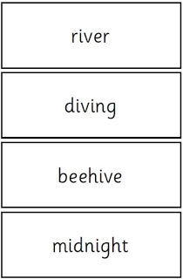
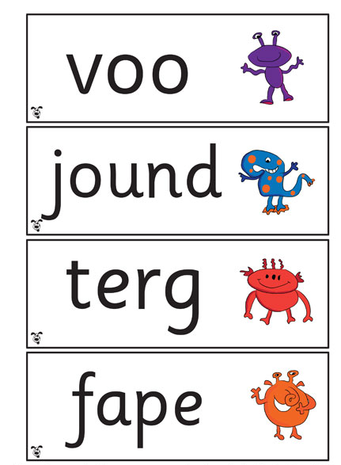
The Test

Slide 16
Reporting to Parents
By the end of the summer term school will report your child's results to you.
We will also confirm if your child has met the standard threshold.
Last year the standard was 31/40 in previous years it has been 32/40.
Children who do not achieve the expected level will access intervention groups and retake the test when they are in Year 2.

Slide 17
How Can I Help My Child at Home?
Play lots of sound and listening games with your child.
Read as much as possible to and with your child.
Encourage and praise – get them to have a ‘good guess’.
If your child is struggling to decode a word, help them by encouraging them to say each sound in the word from left to right.
Blend the sounds by pointing to each one, e.g. /c/ in cat, /p/ in pat, /ng/ in sing, /ee/ in been. Next move your finger under the whole word as you say it.
Discuss the meaning of words if your child does not
know what they have read.

Slide 18
How Can I Help My Child at Home?
Your child’s reading journey starts at home too!
Reading with your child every day is one of the most powerful things you can do to support their learning in Year 1.
Why is reading so important?
📖 Builds FLUENCY
Regular reading helps children read words more quickly, smoothly and accurately, without having to stop and sound out every word.
📖 Builds CONFIDENCE
The more children read, the more confident they become. Celebrate their successes and encourage them when they find something tricky.
📖 Grows VOCABULARY & UNDERSTANDING
Talk about new words, characters, events and ideas. Good readers don't just read the words – they understand them!
📖 Creates a LOVE OF READING
Reading isn't just about schoolwork! Share stories, comics, magazines,
non-fiction books, poems and books about things they love.

Slide 19
How Can I Help My Child at Home?
TALK • READ • ENJOY!
Ask questions such as:
What do you think will happen next?
Which part did you enjoy? Why?
Can you spot a word you know?
Tell me about your favourite character.
We want every child to become a confident, fluent reader who chooses to read because they LOVE it!
Even 10 minutes a day can make a difference.
Read together. Talk together. Enjoy books together.
You are helping to build a reader for life! ❤️

Slide 20

Learning at Home
We are incredibly lucky to have this resource to support reading.
We have provided a Parent Guide for Active Learn for you to use at home.
Please take a copy.

Slide 21
Your child has a login in the front of their Reading Record.
This is a great resource for reading activities.
There is a great selection of e-books which you can read together. A great way for your child to hear modelled reading.

Slide 22

Doodle Learning is fun, engaging and interactive, helping children practise key skills regularly in a way that feels like a game.
It provides opportunities for children to build confidence, develop fluency and strengthen their understanding through activities matched to their level.
Your child has a login in their Reading Record.

Slide 23
Thank you!

