Slide 1
About Italy
We learnt about Italy and Bologna in st peters school
By Aaron, Finley and Sonny

Slide 2
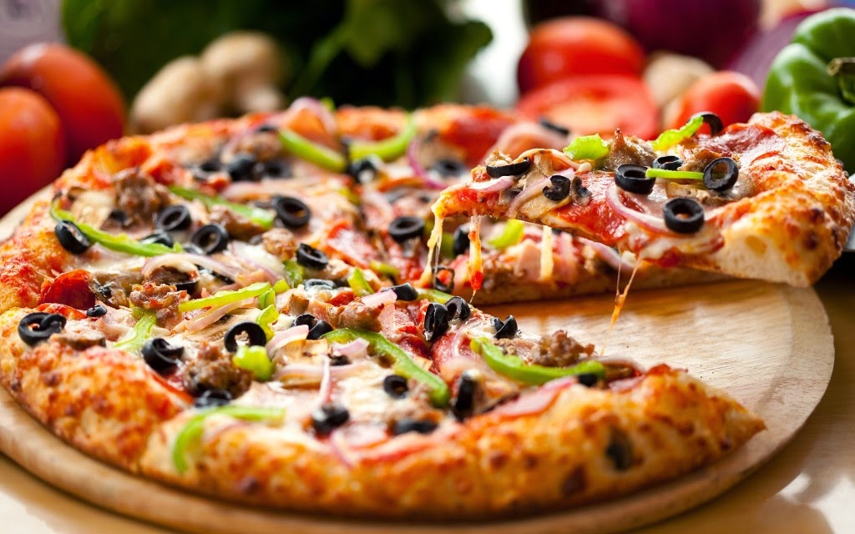
There city food
This is pizza a very famous food in Italy and bologna
A lot of people like pizza and so do we it is made in Italy and everyone in italty likes it.

Slide 3
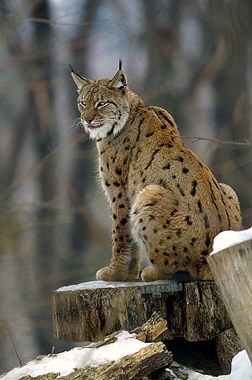
Italy and Bologna animals
This is a lynx it is rare in Italy it is a self defense animal and
Its like a cheetah but is no fast and looks more like a lion
But not as aggressive.

Slide 4

What does the Italy flag means
The colour green is for freedom and white is for faith and red is love .

