Slide 1

All about Italy
Bologna

Slide 2
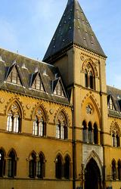
Schools in Bologna
In bologna there are schools but they are very different they stay in primary when they are 3-16. when we stay in primary for 4-11. In bologna you leave high school when you are 17-19. but here we leave high school when we are 15-16.

Slide 3
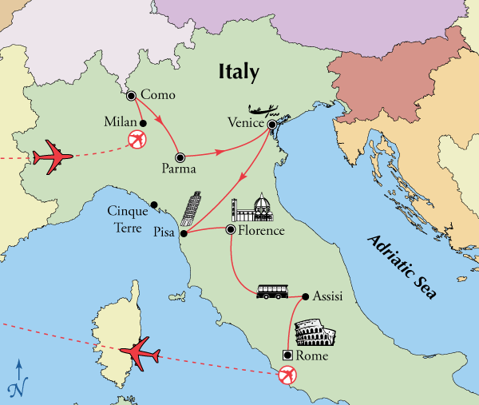
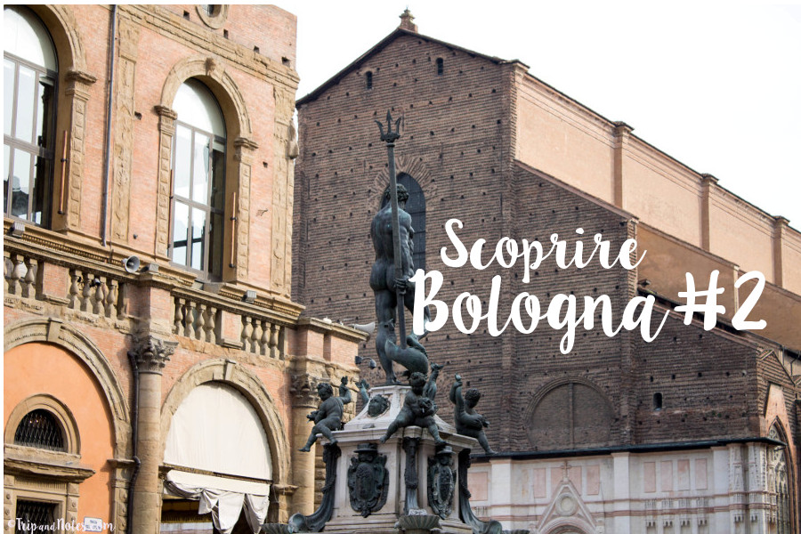

Slide 4
Statues in Bolgna
Lots of statues in Bologna are naked and don’t have clothes on . This is because they want more people to come .
In Bologna there are many statues that’s one thing there famous for . They love there statues because there is many of them in the city.

Slide 5
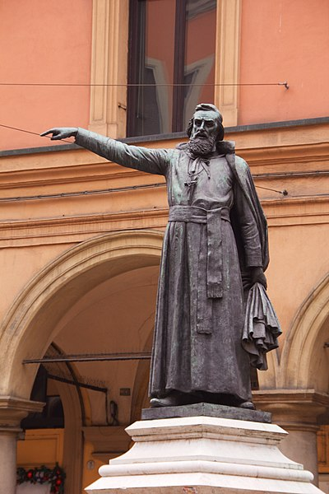
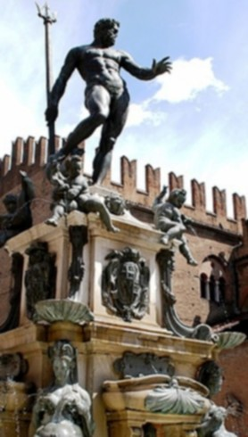

Slide 6
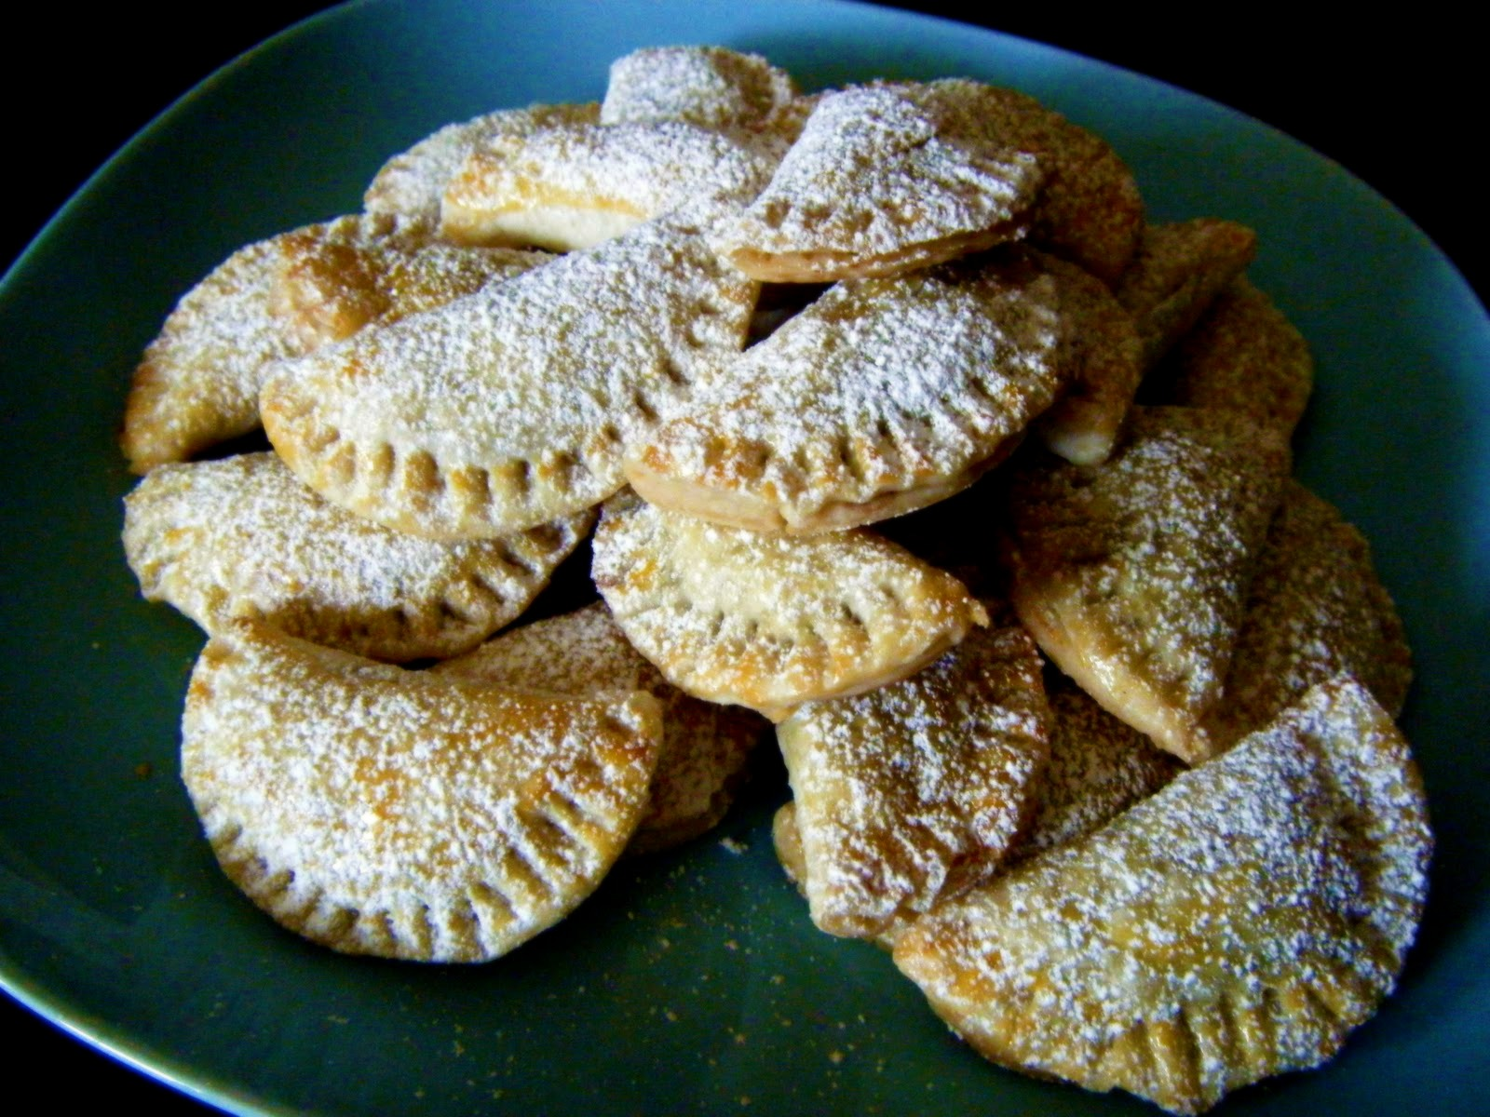
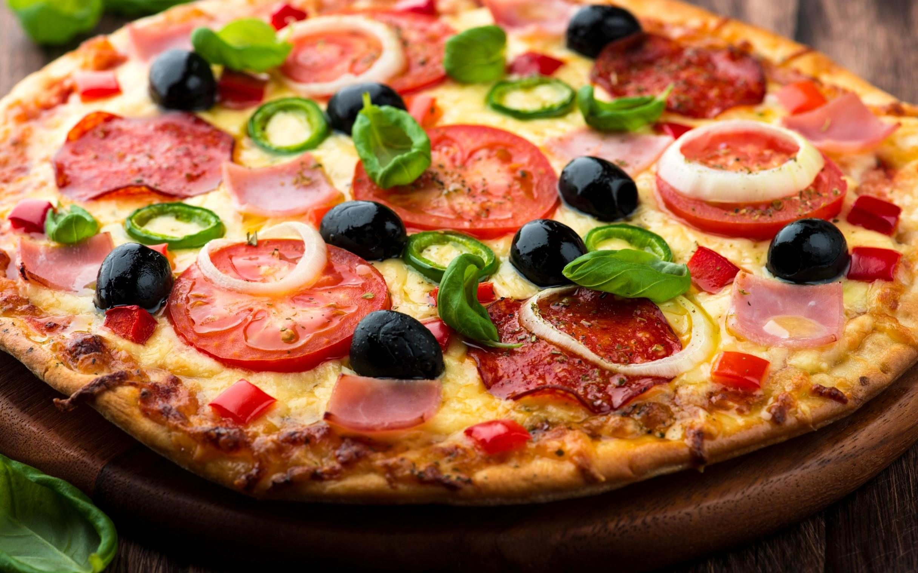
Its citys famous food
In Italy the famous food is pizza,pasta and risotto they eat this because in Italy things are different.

Slide 7
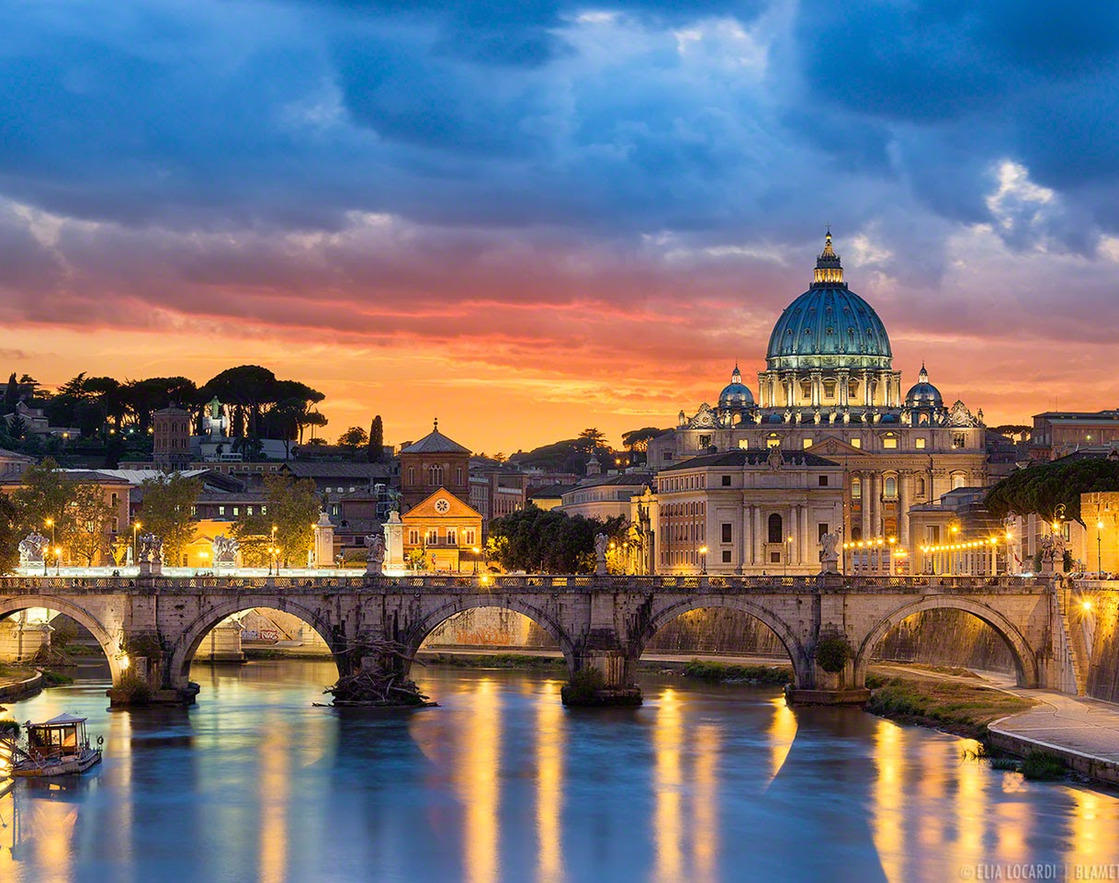
Holidays
Holidays in bologna are very hot because they are in the Mediterranean which means its hot .is bologna a good place to go on holiday? would you go?

Slide 8
questions
Did you like learning about Italy bologna? What are some intresting facts you know? Do you want to go on a holiday at bologna

Slide 9

By Es’zmae and Emily

