Slide 1
Italy
Bologna
by Ella and Catrin

Slide 2
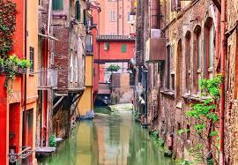
Bologna
Italy is home to many regions, in particular the Emilia-Romanga region, this is where Bologna is.
Read on to find out more!

Slide 3
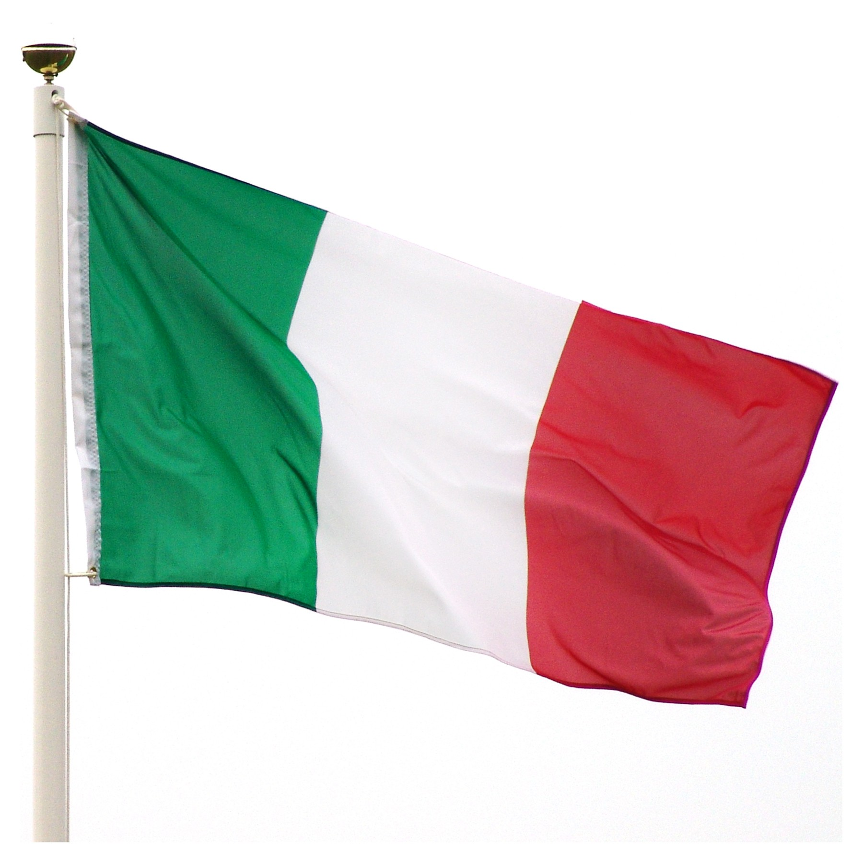
What does the flag stand for?
In the Italian flag green stands for freedom.
White stands for faith.
Red stands for love.

Slide 4
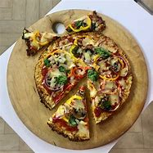
Food!!!!
Food is a big part of Italy. These are some of the food its famous for, they love pizza, pasta cheese, wine and ice-cream.

Slide 5
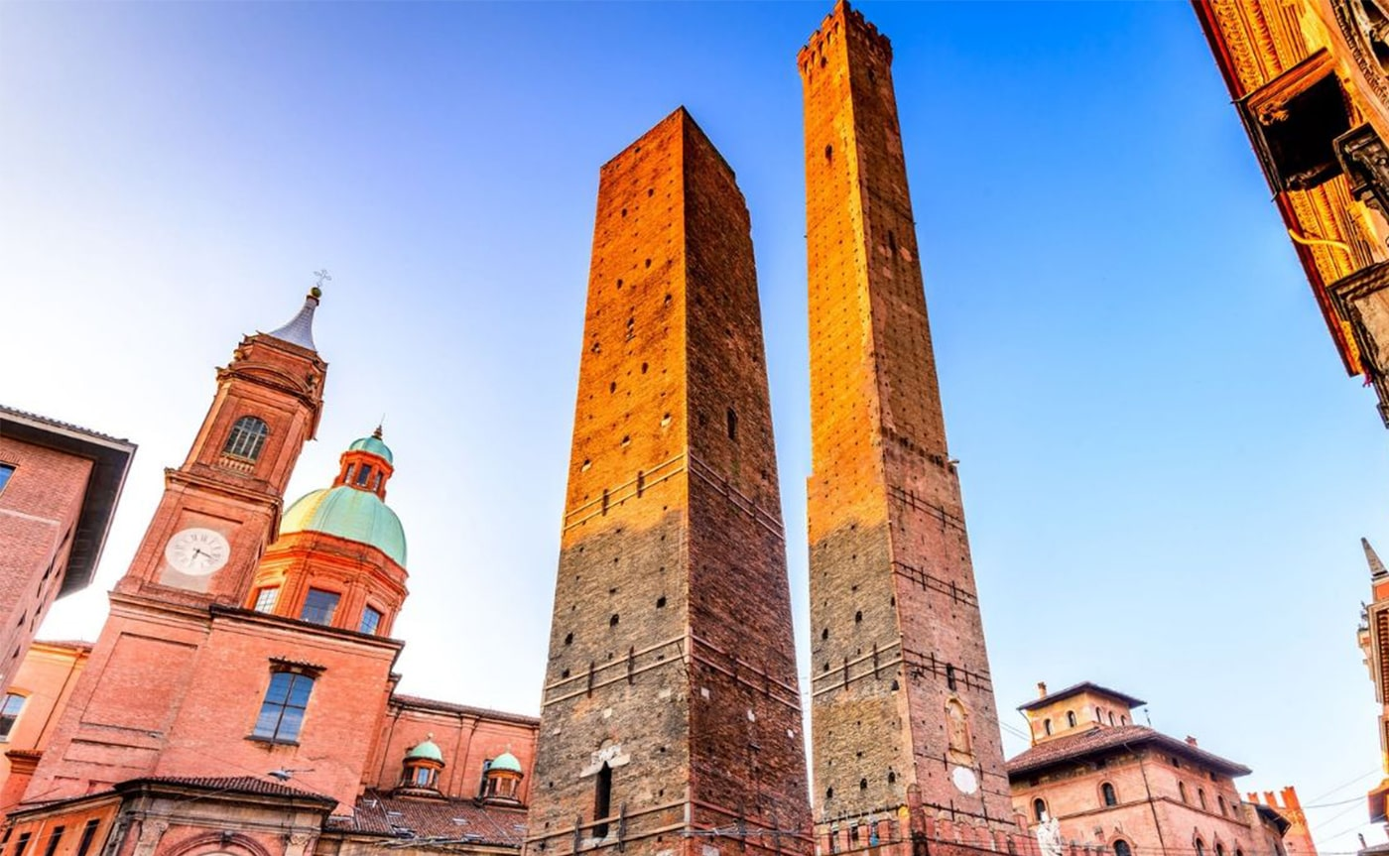
Buildings
There are many buildings in Bologna , most of them have lots of history hidden behind them including this one!

Slide 6
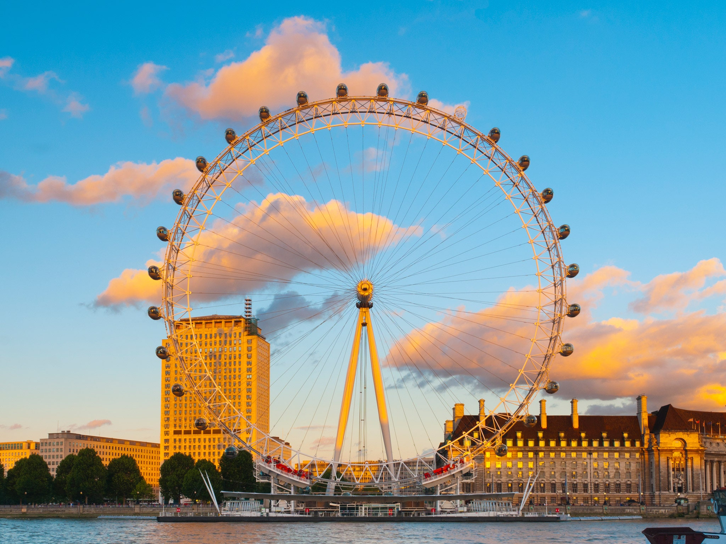
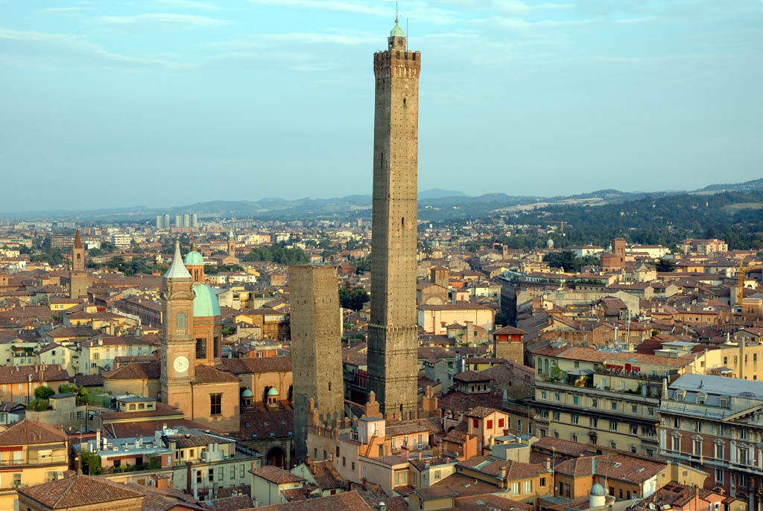
England vs Bologna!
Which one do you think you’d like too visit
England!
Bologna!

Slide 7
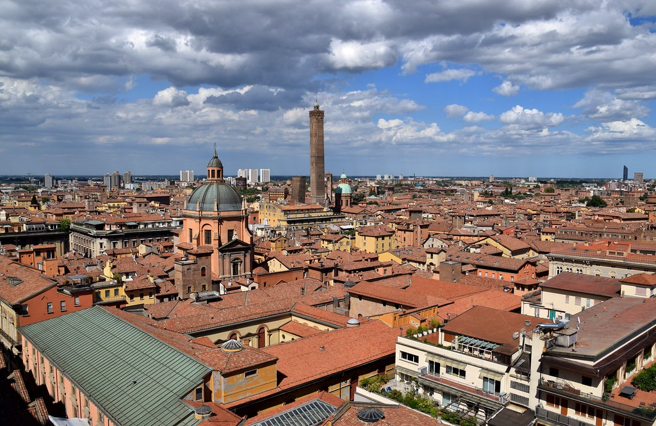
FUN FACTS
Italy won the song contest Eurovision in 2021!
The city covers a total area of 141 square kilometres!
The population of Bologna is 400,000 people!

Slide 8
Revision!!!!
What city have we been learning about?
Name 3 foods Italy is famous for
What reigon is Bologna in?
What does the green represent on the flag?
Bologna
- Ice-cream, pizza, pasta, cheese
Emilia – Romanga
- freedom

