Slide 1
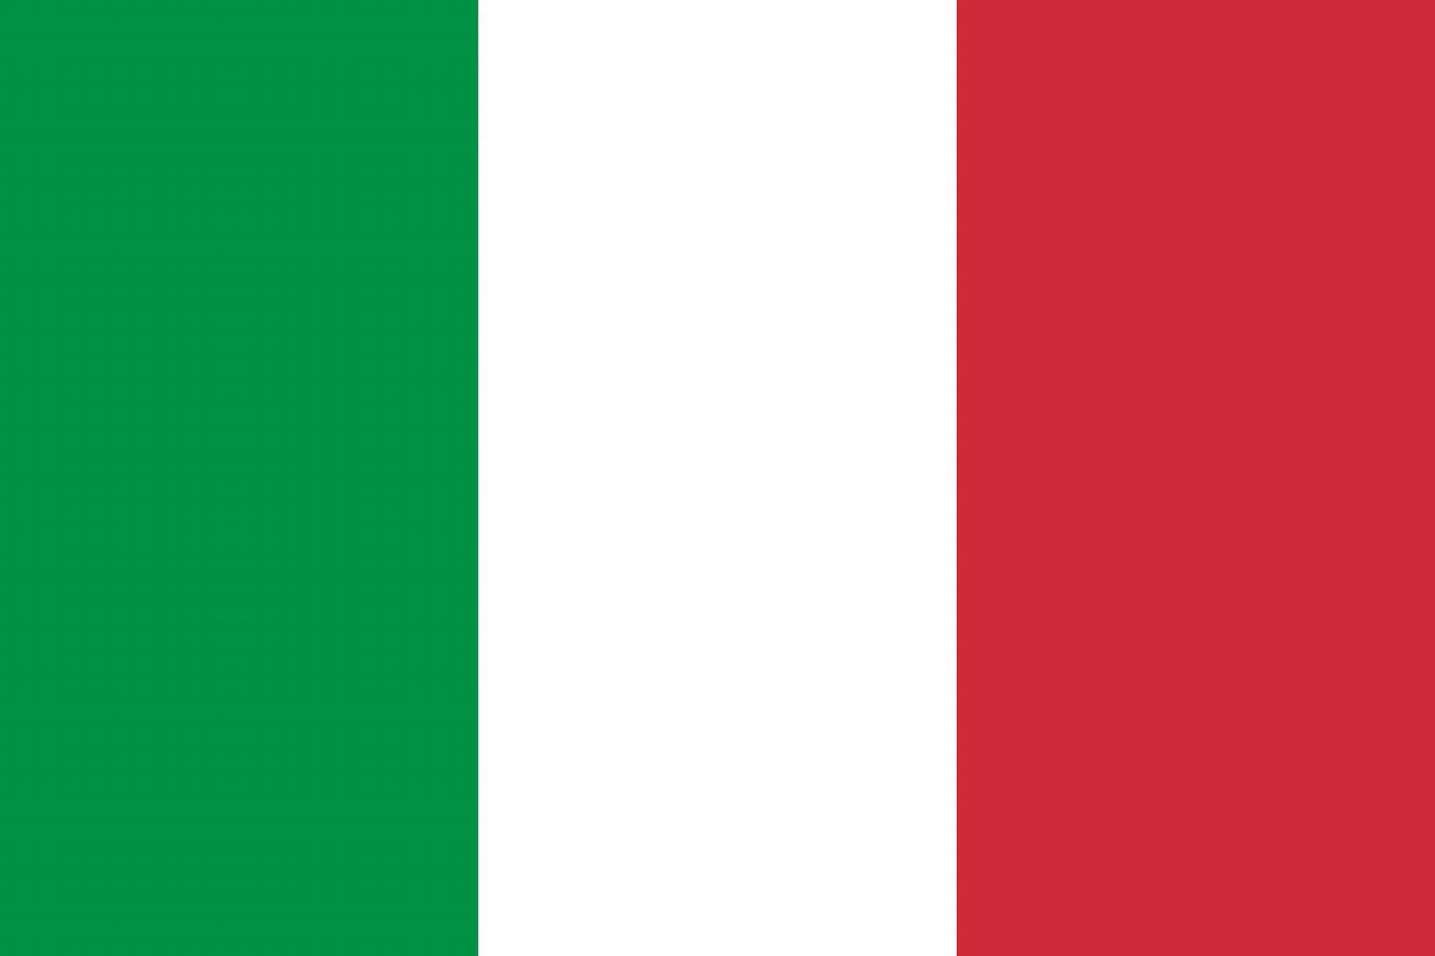
Italy
Bolongla

Slide 2
Good Or Bad?
GOOD
BAD
Food
Landmarks
Tonge – Language
Shape of country
Naked statues
12 o’clock

Slide 3
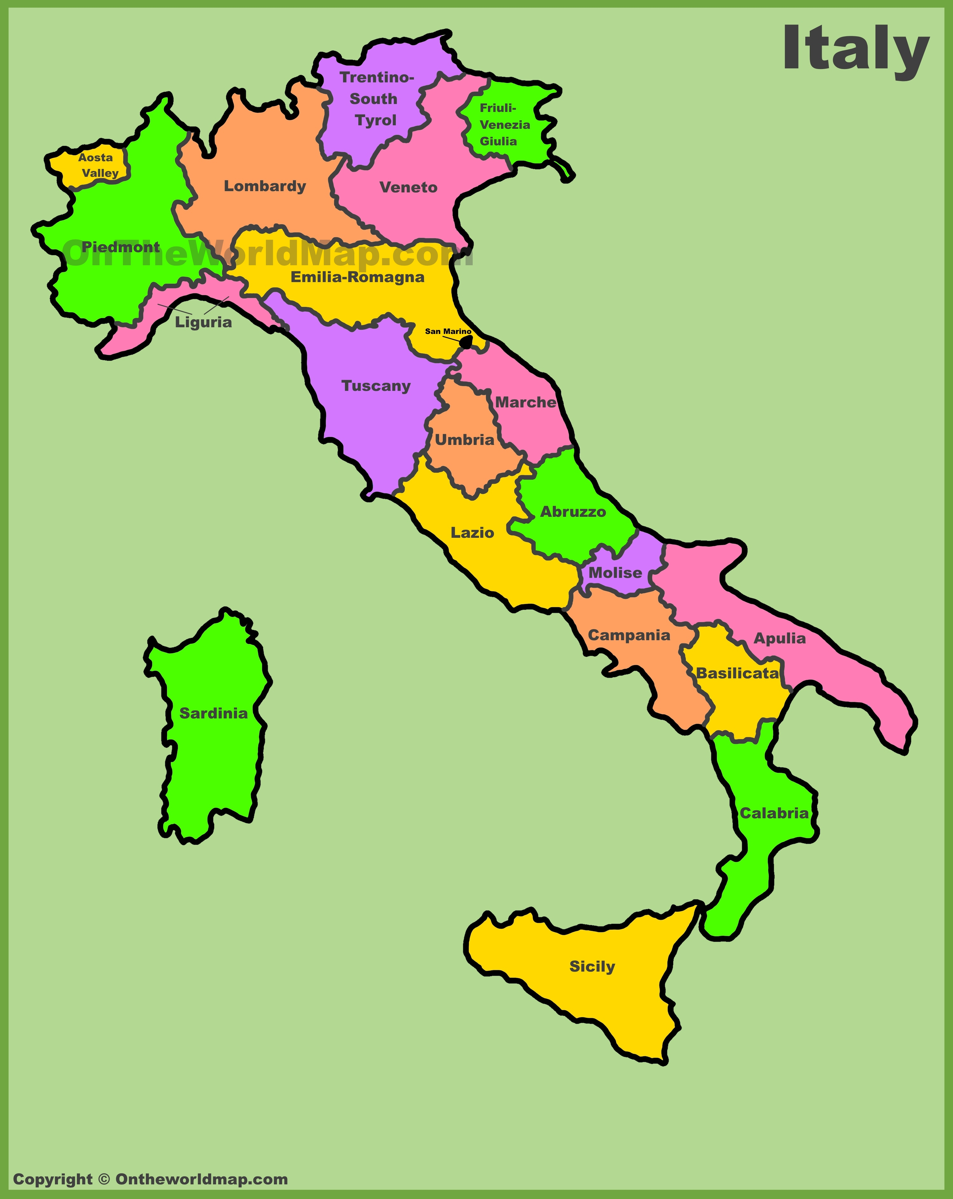
Were Is Bolonga
Bolongla is in the south of Italy.
It is a reigon

Slide 4
Statues In Bolonga
Statues in this region some are unique in a weird way…Anyway they are all undressed how sneaky!

Slide 5
wolfs
Wolfs are the famous animal in Italy.

Slide 6
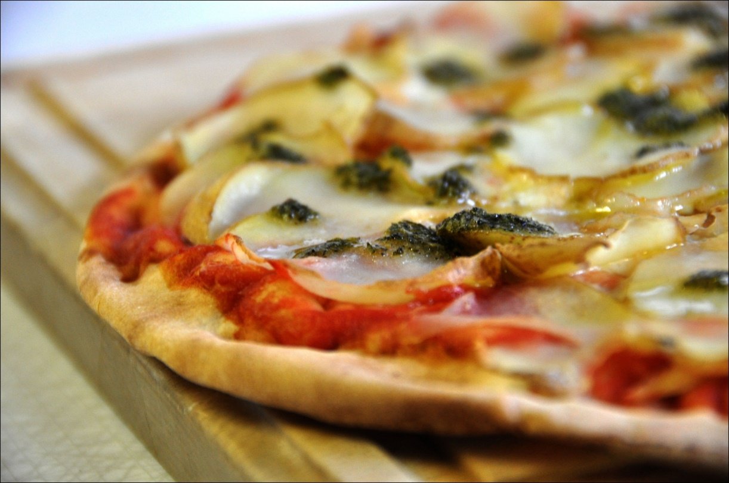
A pizza is a famous treat to have in Italy!

Slide 7
Thank you
By Amy and Molly

