Slide 1
Italy
Amazing facts about Italy
Rocco Erin Jack

Slide 2
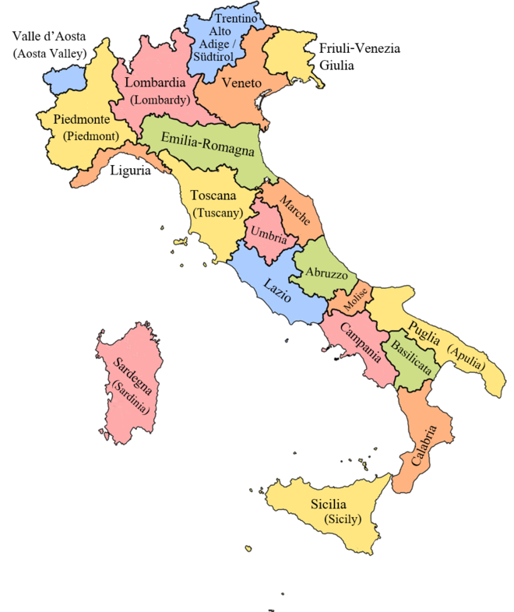
Where is Italy?
You can find Italy easily because when you look on a map you find a shoe kicking a ball. Italy is found in the Mediterranean. Italy is in Europe.

Slide 3

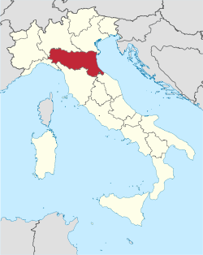
Emilia Romagna Bologna
Bologna is in Emilia Romagna.
Emilia Romagna is in red on the map which includes Bologna.

Slide 4
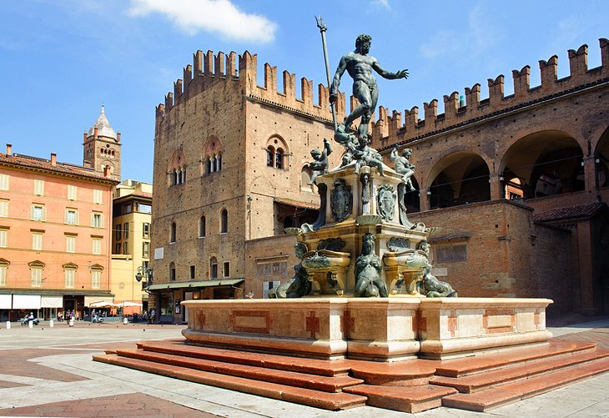
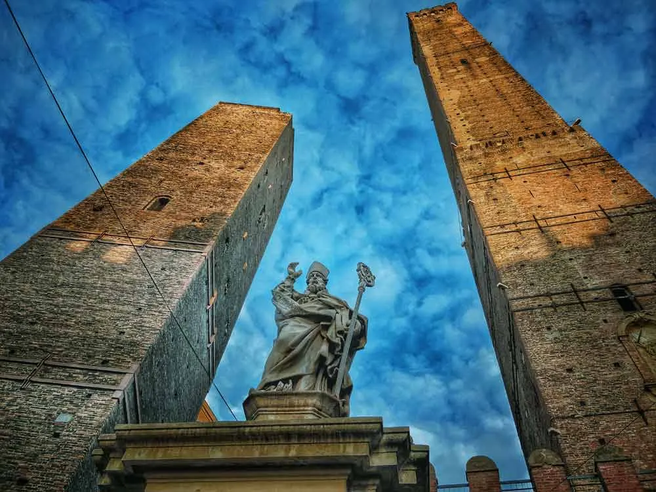
Famous land marks
  Bologna has many different artefacts (witch are famous land marks).

Slide 5
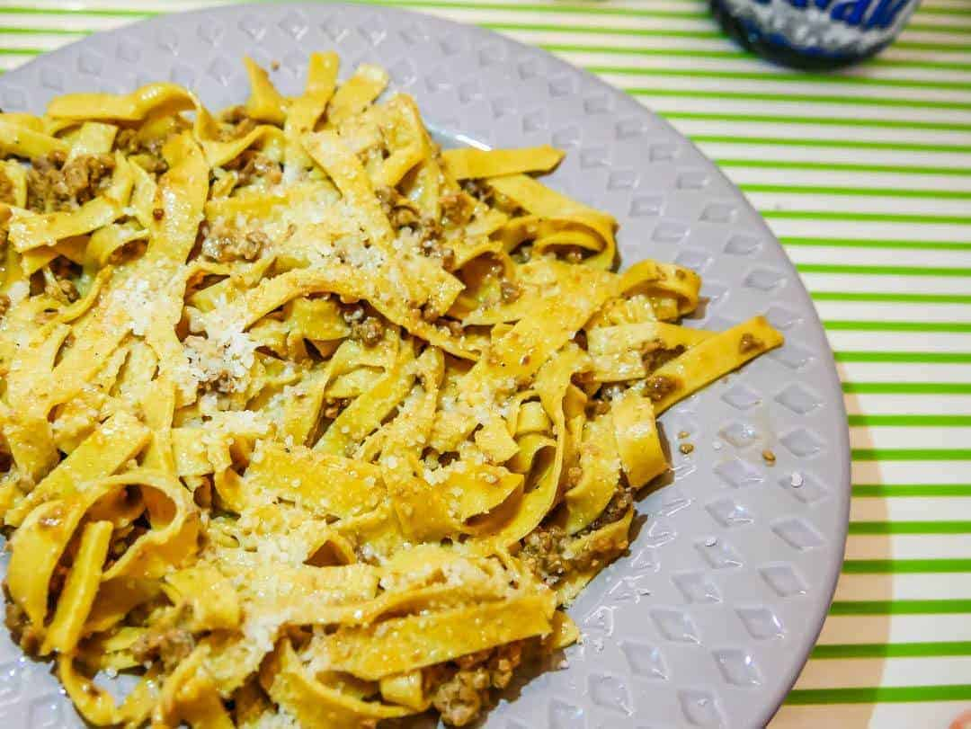
WHAT IS THE MOST FAMOUS FOOD IN BOLOGNA
Bologna is famous lasagne and pasta .

