Slide 1

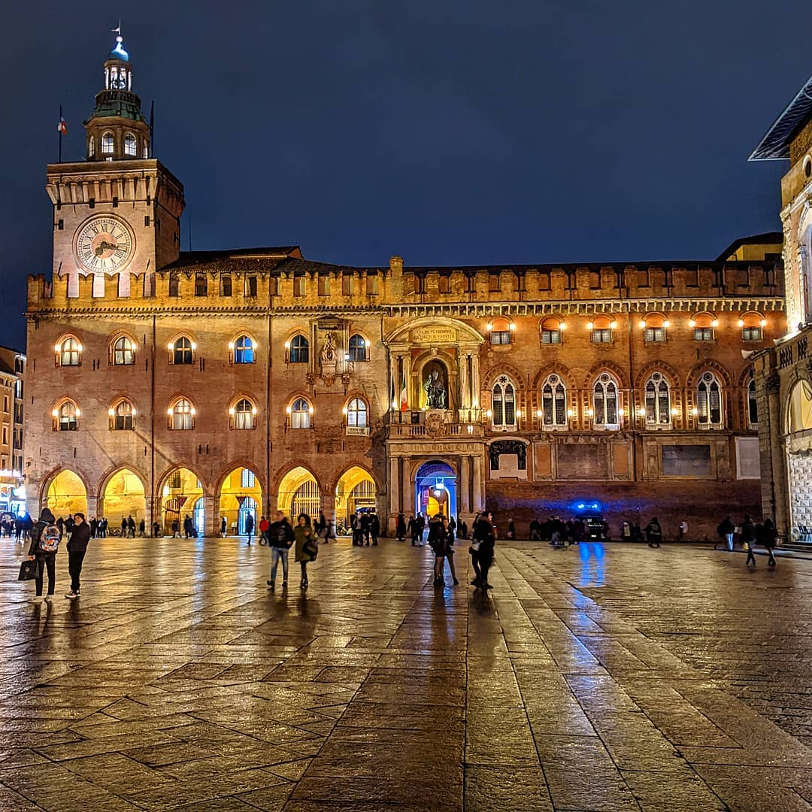
Italy facts by Gracie and Ruby
What is it like to live in Italy?

Slide 2
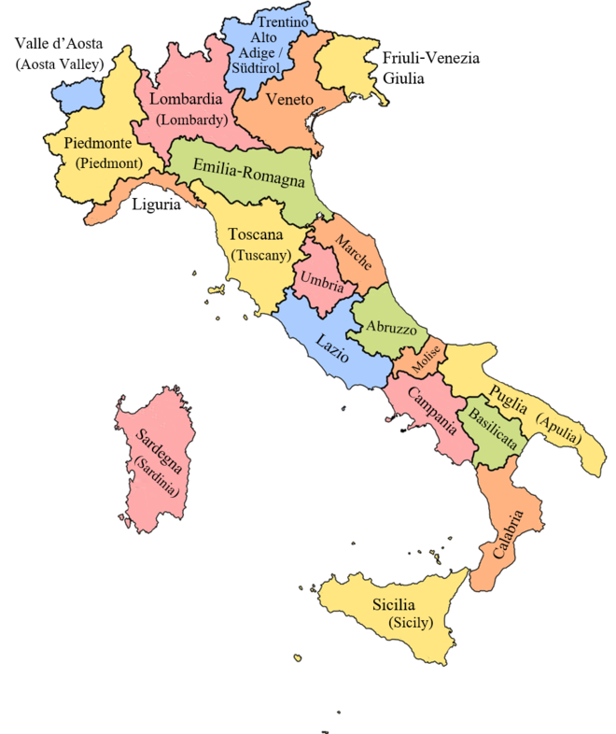
This is the map of Italy
Over the past few weeks we have been researching a region in Emilia-Romagna named Bologna.

Slide 3
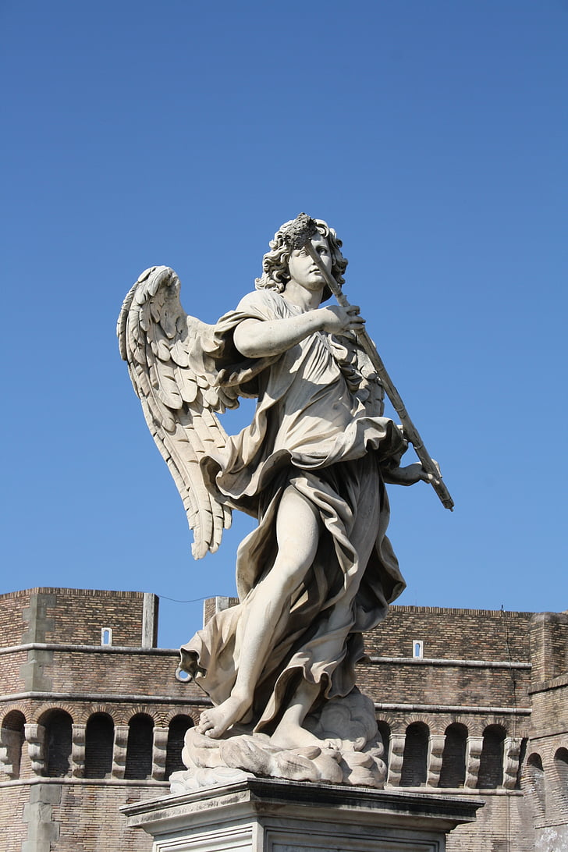
These are statues in Bologna
There are a lot of statues in Bologna .These statues are very interesting! Some statues in Bologna wear clothes where as some don’t.
How cheeky!!

Slide 4
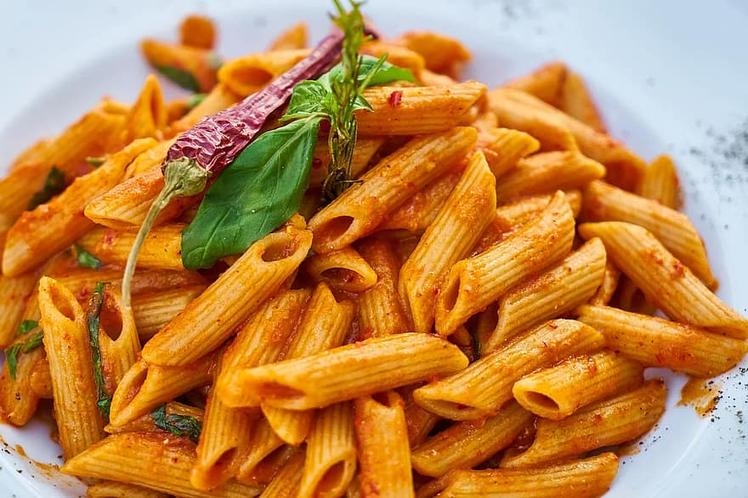
Famous food in Italy
Italy is known for the the famous foods pasta and also pizza(very yummy)the most famous pizza is pizza margareta do u know why? Its named after the queen of Italy.

Slide 5
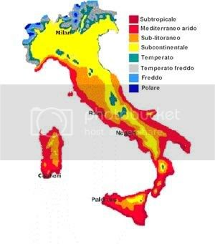
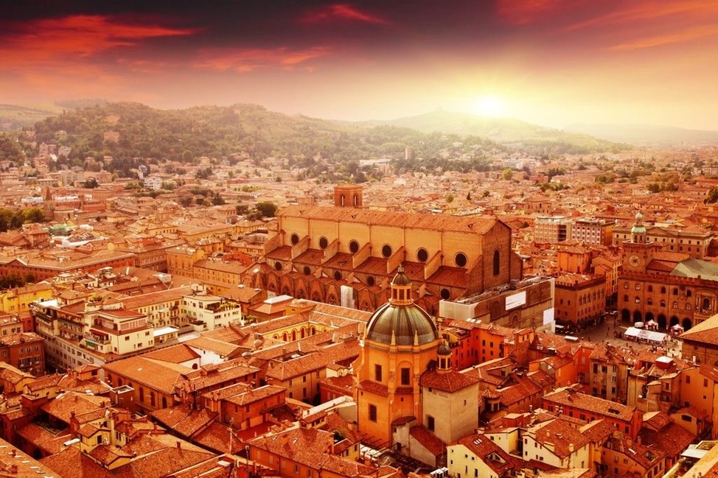
The weather in Italy

Slide 6
The weather in Bologna is mostly sunny ,although it does have snowy mountains that are perfect for skiing!!
The weather is sunny in some parts but cold in other places.

Slide 7
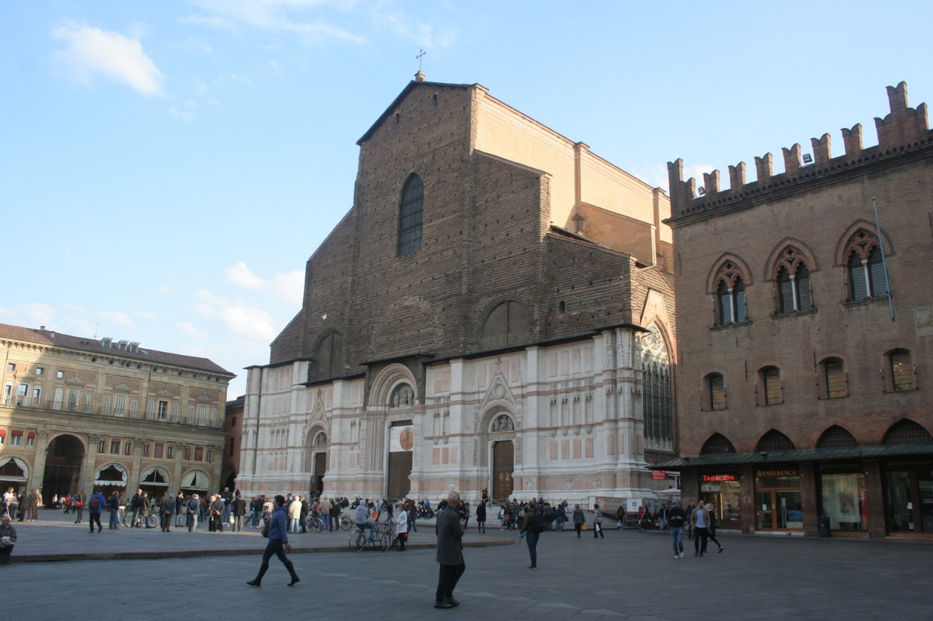
True or false?
Is Bologna a tourist city?
Yes it is! people go there because of the places ,foods and many more.

Slide 8
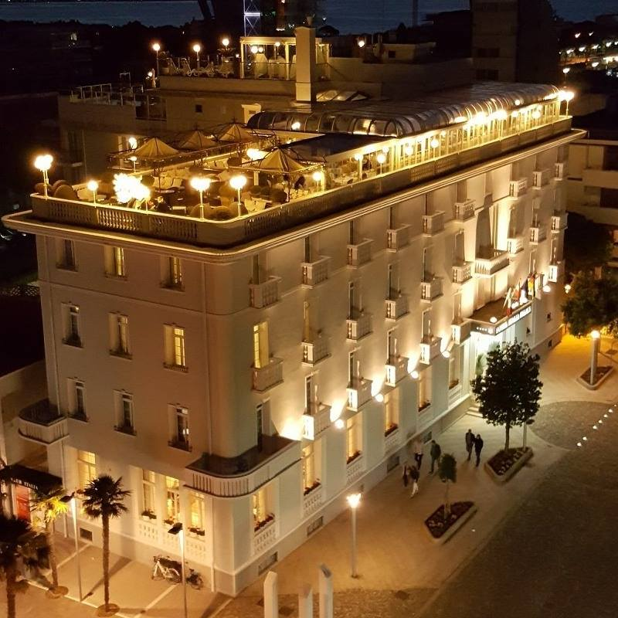
Where can you stay in
Bologna?
This is a modern hotel in Bologna.
Bologna has very beautiful hotels since it is a very stunning city!!
Mi piacerebbe andare li!
That is I would love to go there in Italian!

