Slide 1
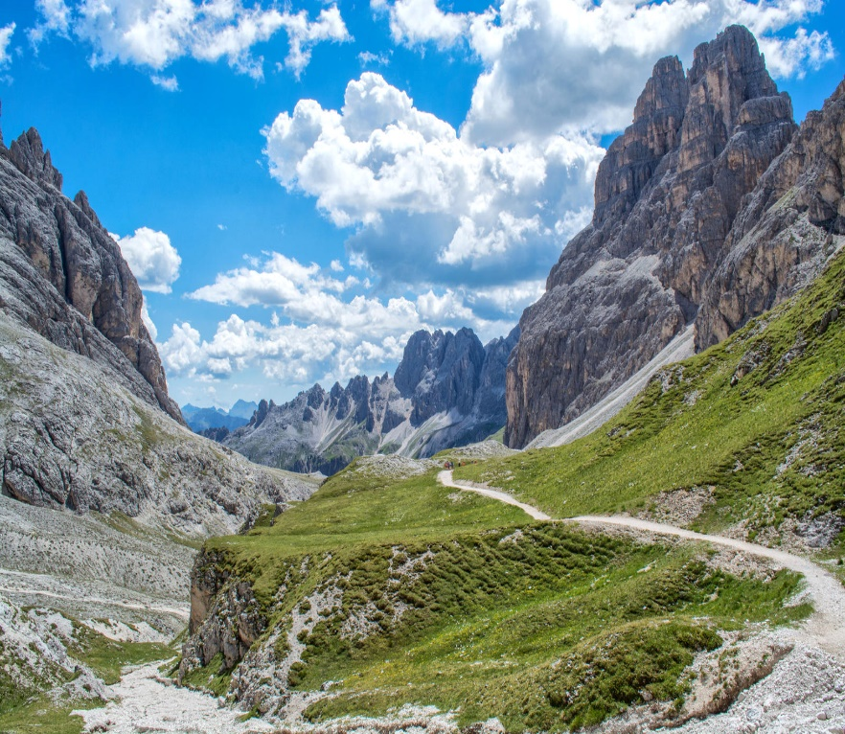
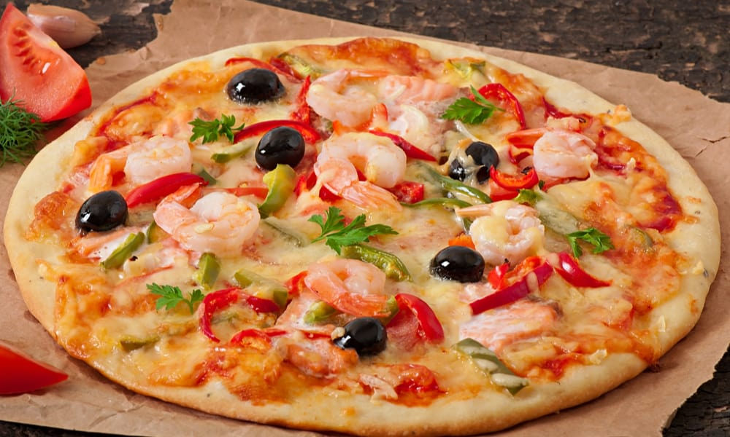
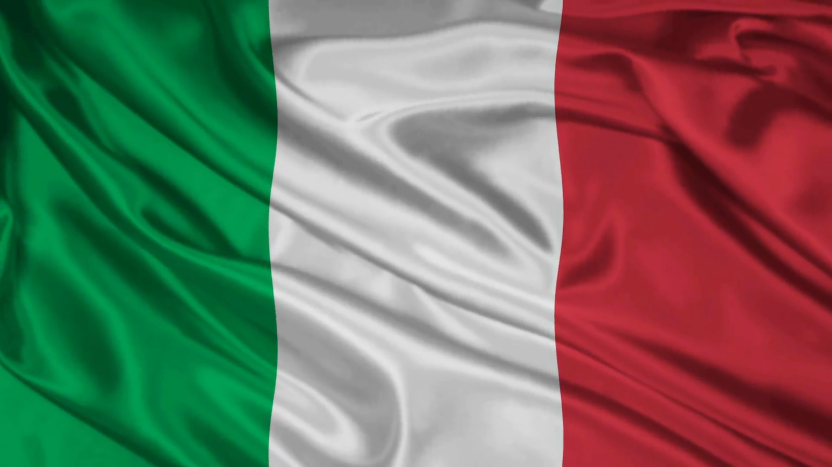
Italy facts Riley, Vincent and Jasmine

Slide 2
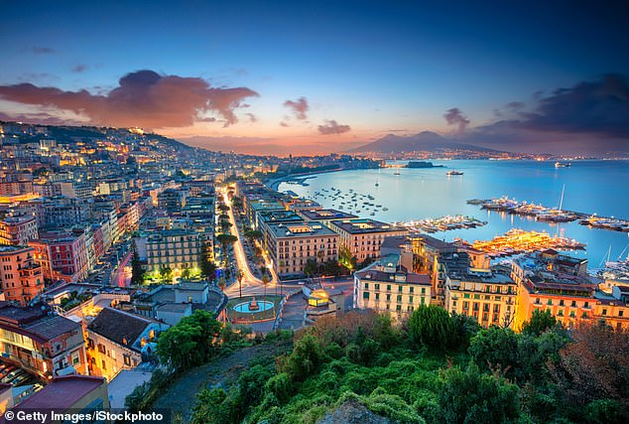
Italy’s city
Its very hot in Italy/Bologna because its next to the equator.

Slide 3
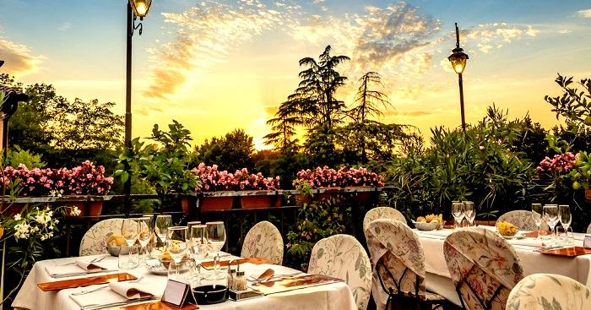
Bologna’s zoos
Bologna has really beautiful restorants just like this image here.It has delishous food to.

Slide 4
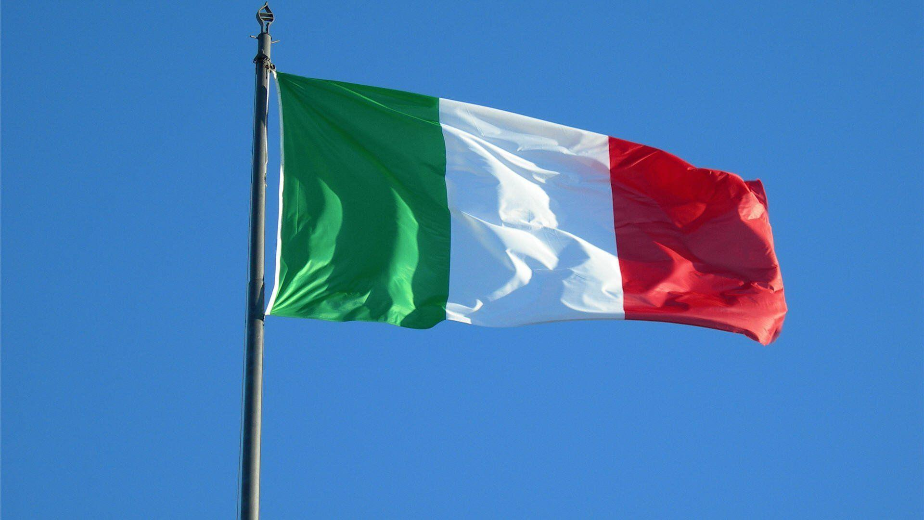
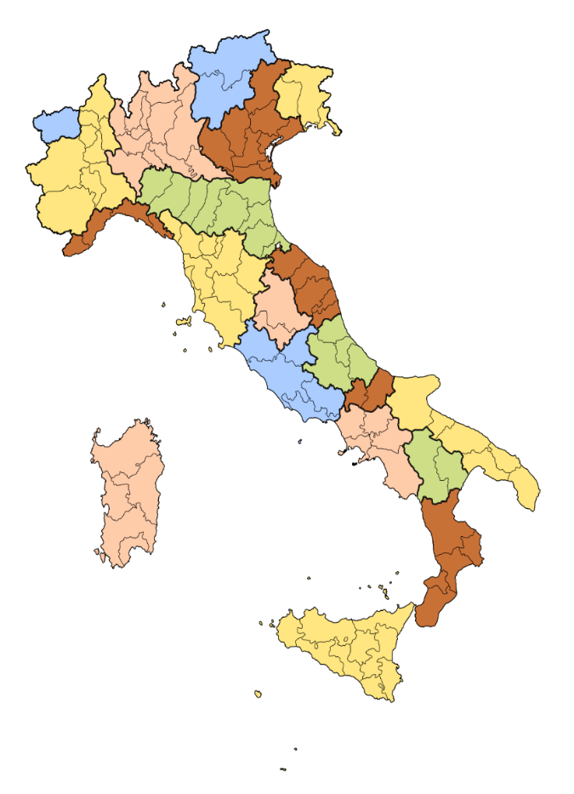
Learning about Italy
We have been learning about Bologna and Italy for four weeks. We have been learning about its schools and history like a volcano called Campi that killed a whole village.

Slide 5
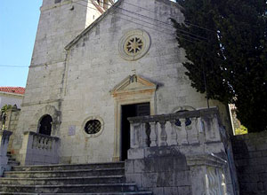
Bologna schools
University Bologna is ranked 177 in the best global university. Italy has both public and private Bologna has free education to children all over the world. It is very different to our schools because it’s a mixture of primary, high school and collage.

Slide 6
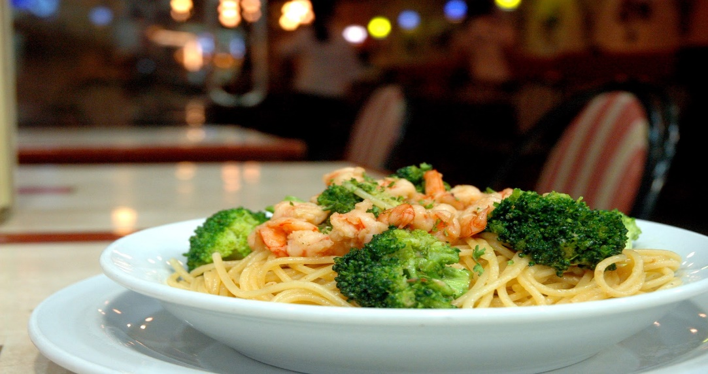
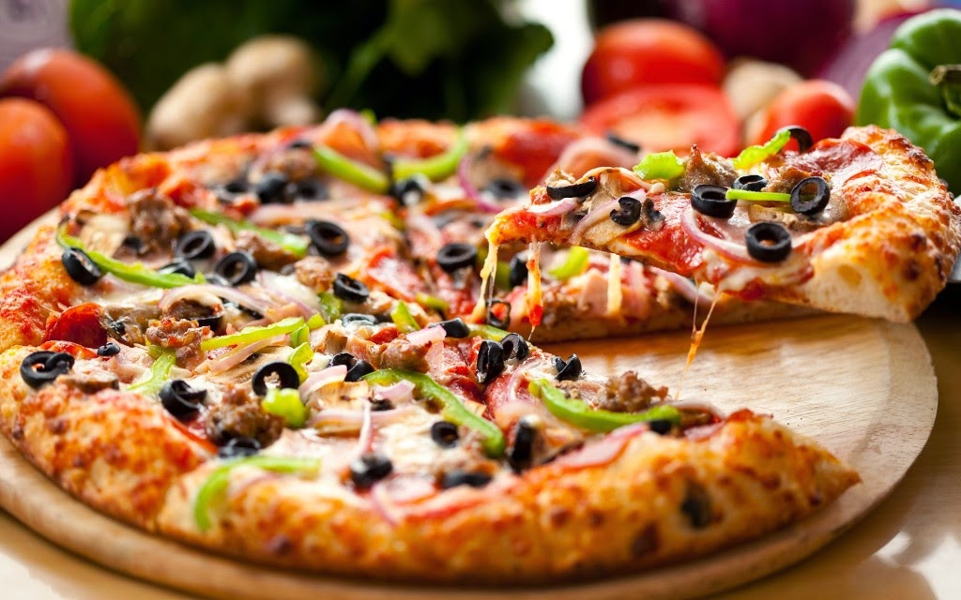
Italian food

