Slide 1
All about Bologna
Why is Bologna a tourist country?
By Oliver, James and Amelia

Slide 2
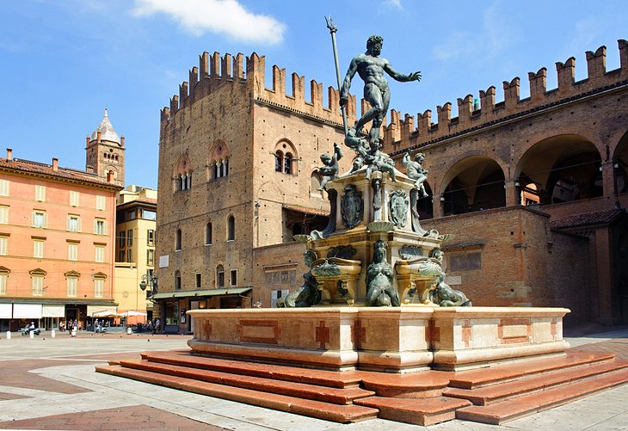
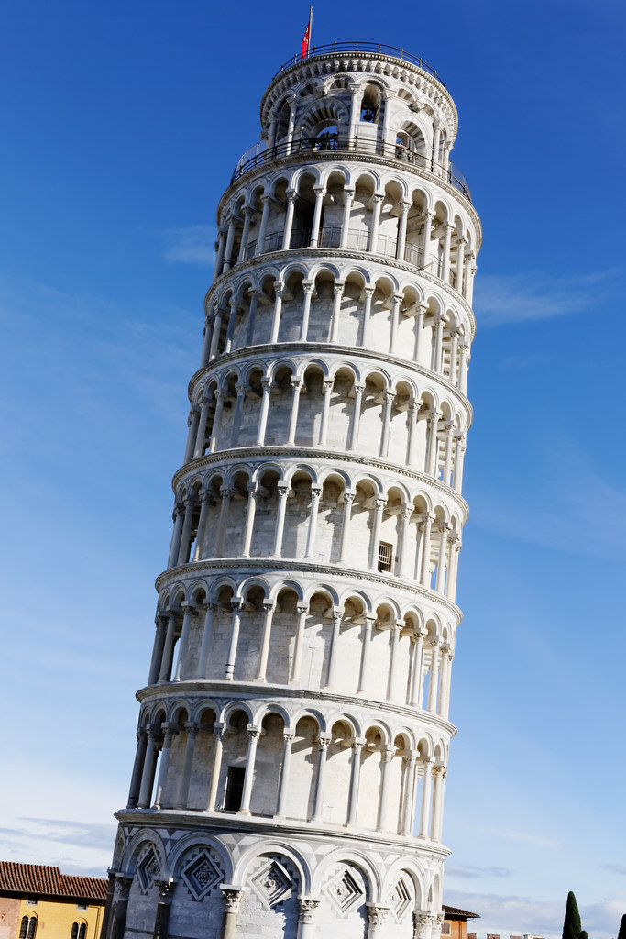
Why is Bologna a tourist country?
Bologna is a tourist city because of the interesting landmarks around the city. As well there are ancient artefacts in the museum as well underground. Like then leaning tower of pizza.

Slide 3
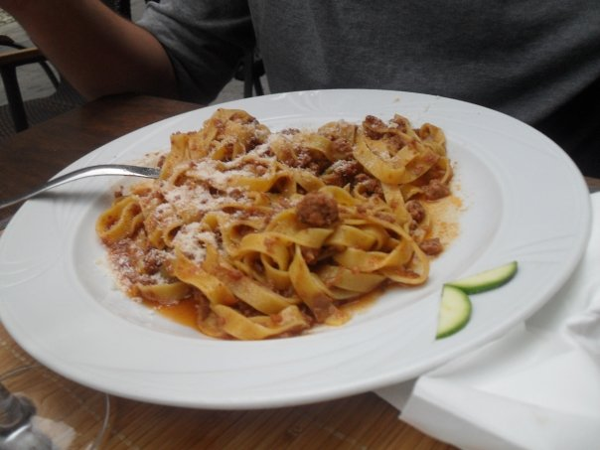
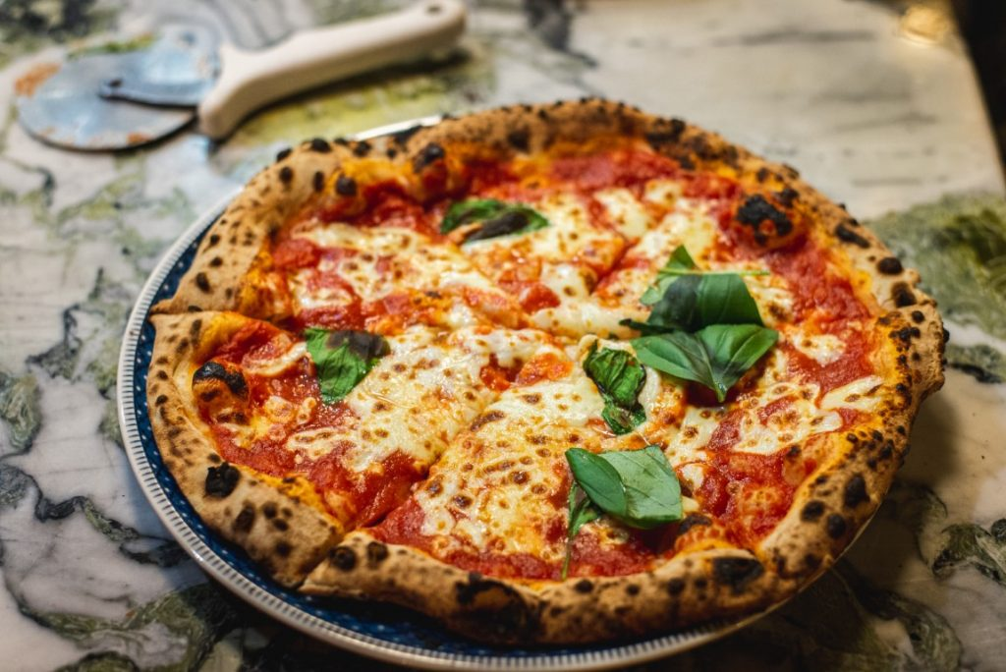
What is Bologna famous for?
Bologna is famous for its food. Mostly its spaghetti because it tastes fab and its also famous for its margarita pizza.

Slide 4
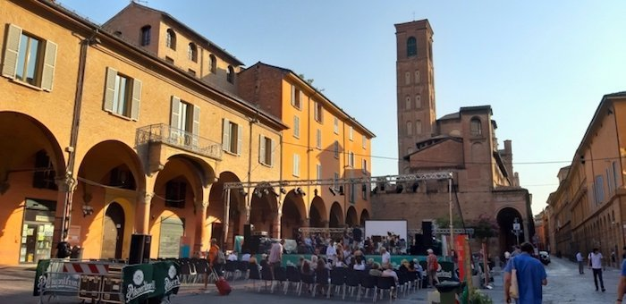
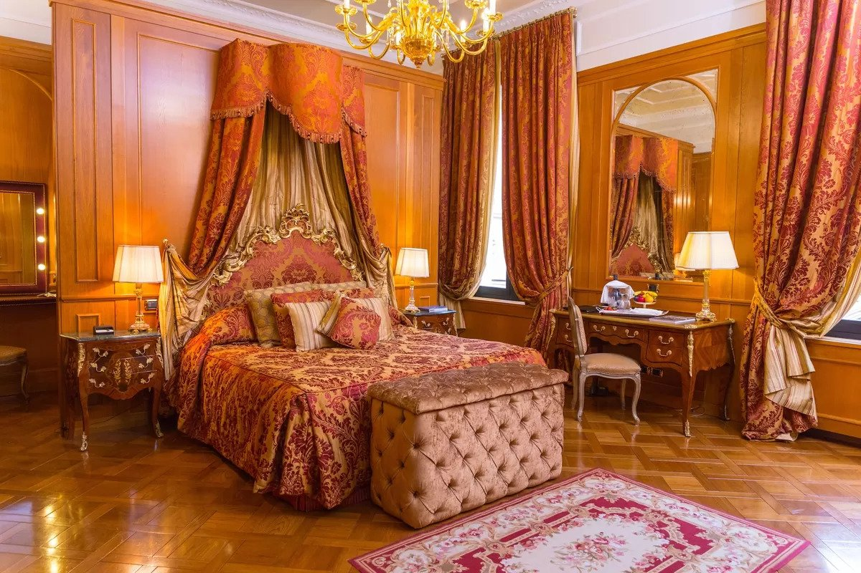
What is Bologna famous for?
Its famous for its food and landmarks around the city.
As well as its wonderful, fancy hotels!

Slide 5
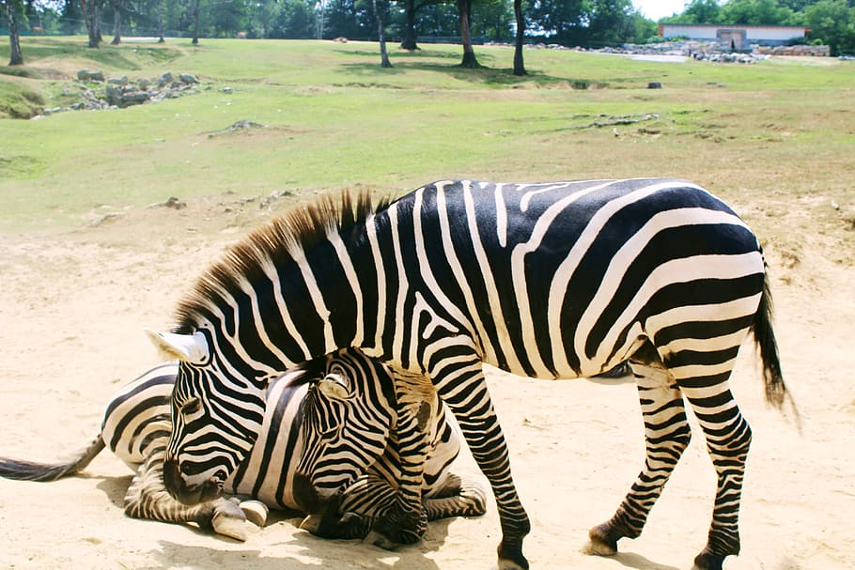
Famous animals in Bologna zoo
The zebra is a famous animal in Bologna. As you can see they are very playful animals and there is a baby zebra and they are black and white. They live in a very hot place and are well looked after. They live in a zoo.

