Slide 1

Knowledge About Italy by Marlo and Bailey

Slide 2
Are you ready to dive into the city of Bologna?

Slide 3
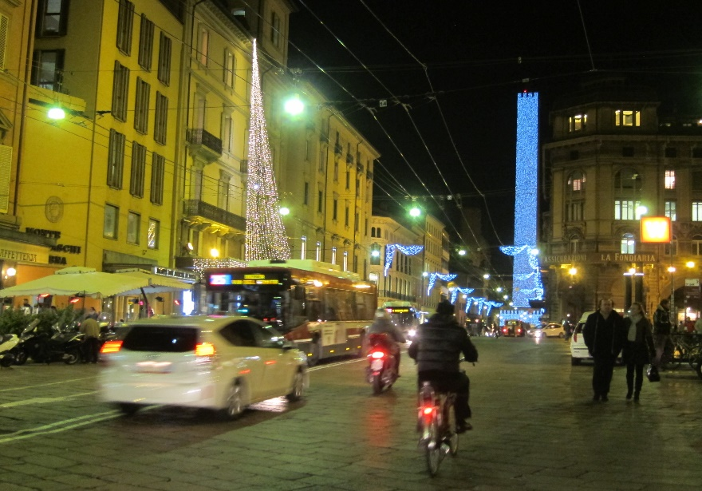
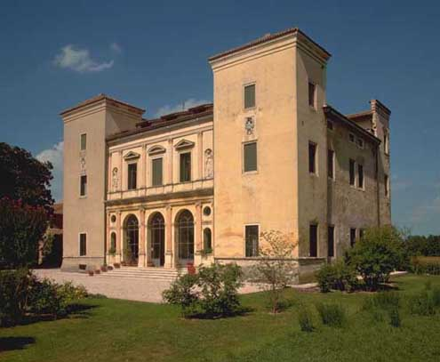
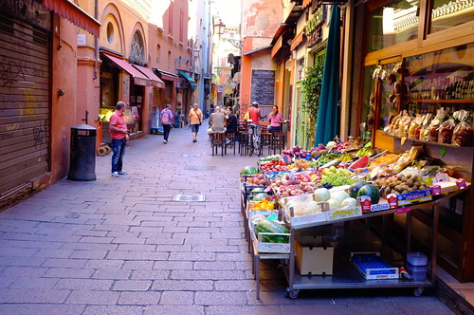
The Amazing Region of Emilia-Romagna
We studied on Bologna the region of Emelia-Romagna and we met children from a school in Bologna and compared their lives to ours we looked at tables of their daily lives and we filled in tables of our daily lives.

Slide 4
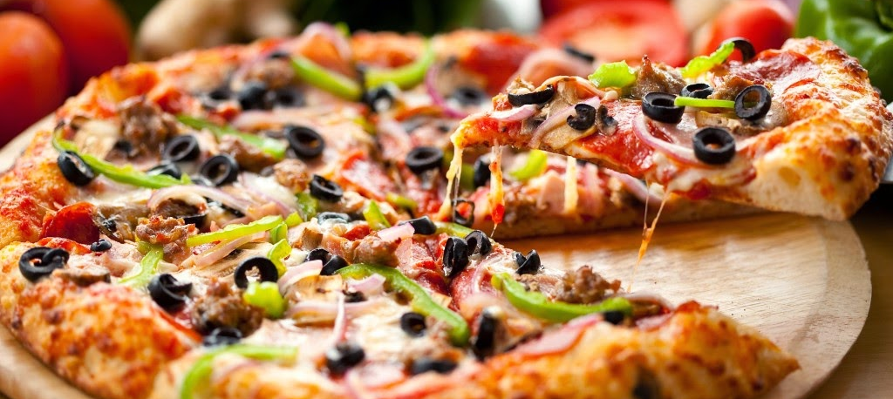
Bologna’s Famous Food
Pizza and pasta are Bolognas specialties because they sell the most scrumptious pizzas and pasta.
They also put unusual toppings on their pizzas.

Slide 5
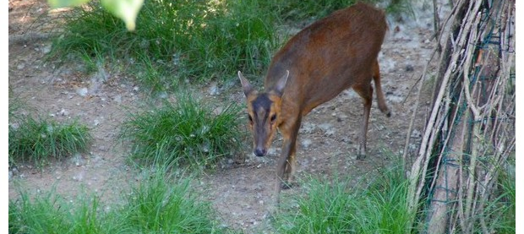
Animals in Bologna
Bologna has its good animals and bad animals they have animals such as wild deer.
They even have some cool insects and bugs.

Slide 6

What Facts do You Know About Bologna?
People visit Bologna for the food and the sights.
Statues are commonly found in Bologna and tall buildings are all over this city.
People also visit to see people such as family and friends.

