Slide 1


ITALY
Bolonga

Slide 2
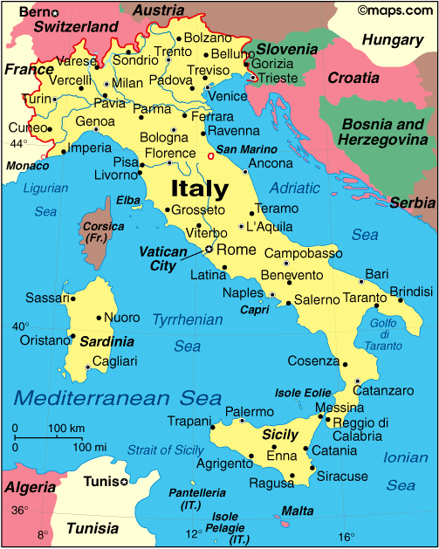
All about Italy
We are focusing on facts about Bologna. Bologna is in Emilia-Romagna it has various landscapes and lots of delicious foods .

Slide 3
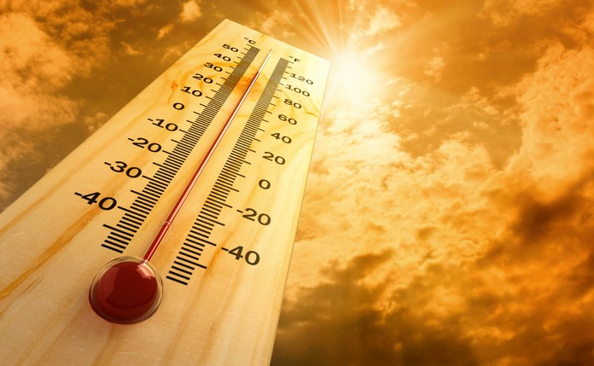
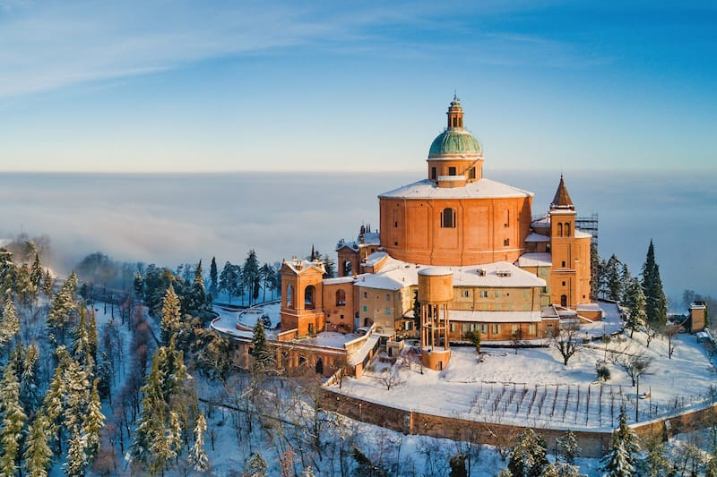
Weather in Bologna
Can you spot the difference below.
It is very hot in Bologna because it is near the equator. The hottest temperature that ever happened was in 1999 and reached up to exactly 39.6 degrees.
It if it gets below 0 degrees a lake will freeze. and once in 1991 it was negative 15 degrees.

Slide 4
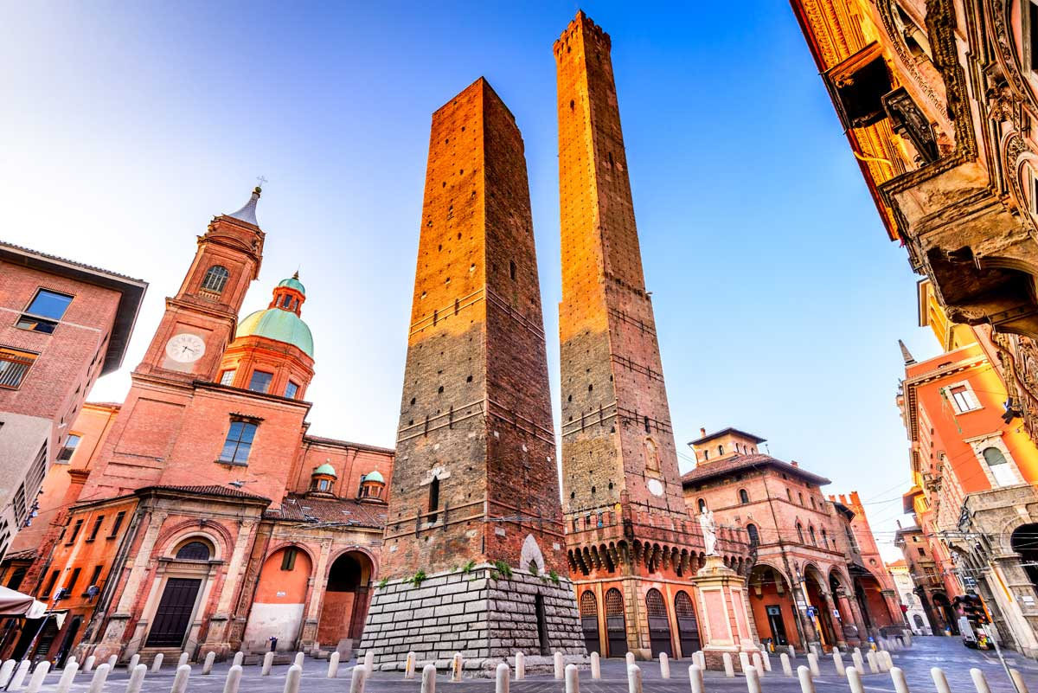
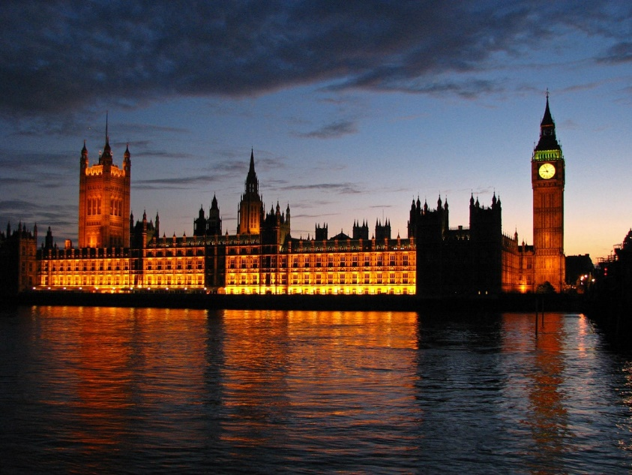
Bologna landscape and England landscape
Bologna
England

Slide 5
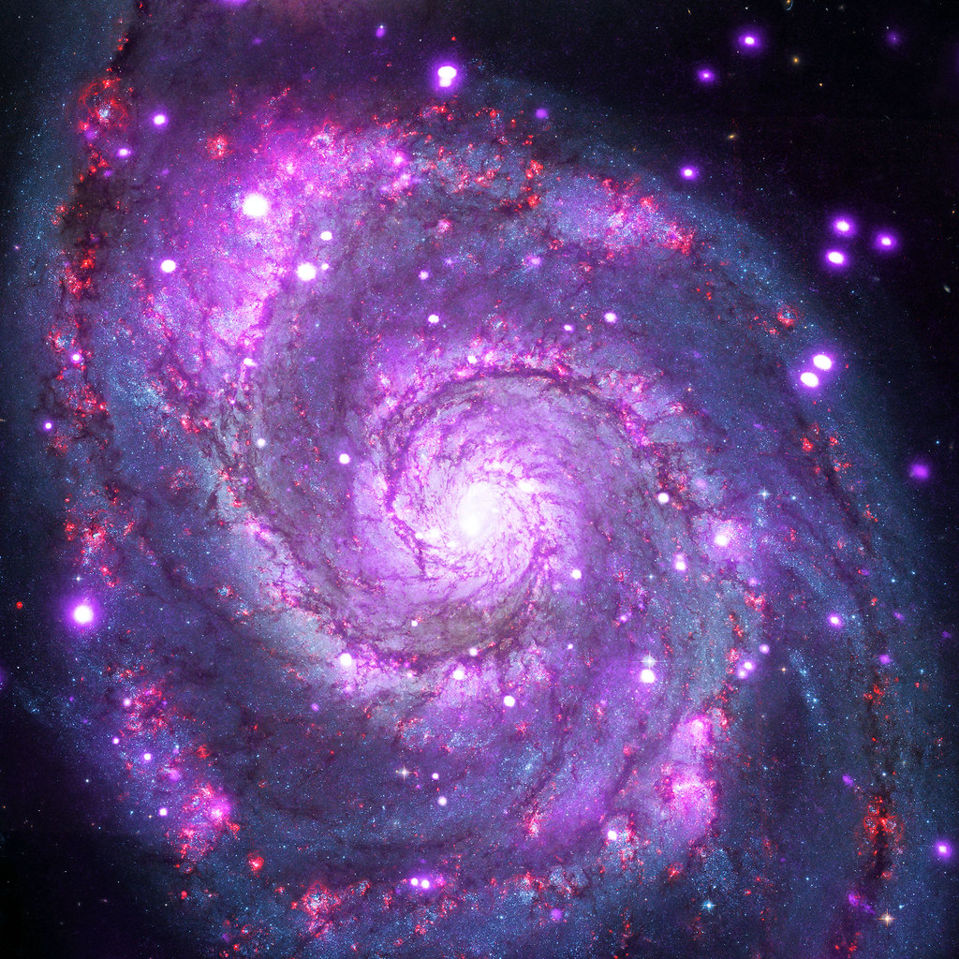
Fun facts
Rome is in balongna
MAY 2020 the population of Bologna is about 400,000 people. It is the second largest city In Italy

Slide 6
By Rahim and Aisha

