Slide 1
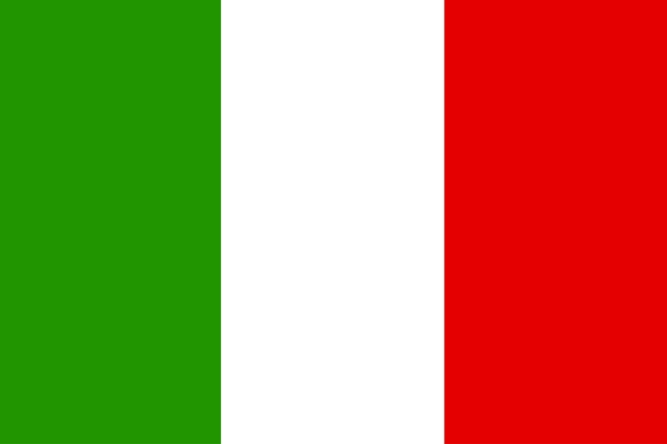
All about Italy
Bologna
Sam c and Tommy

Slide 2
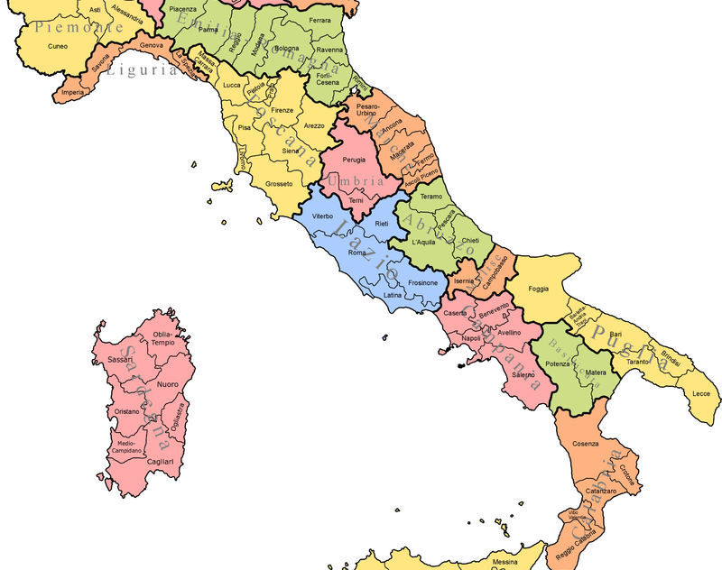
Regions of Italy
This is It Italy, near the Mediterranean sea. Italy is home to Bologna in Emilia Romagna. The places that split up Italy aren’t called counties they are called regions.

Slide 3
Differences and Similarities to England
Similarities
Both places have schools
We are both tourist spots especially London and bologna
Both trade and sell
Differences
Climates sun rain
Style arceteture
Times of day and night

Slide 4
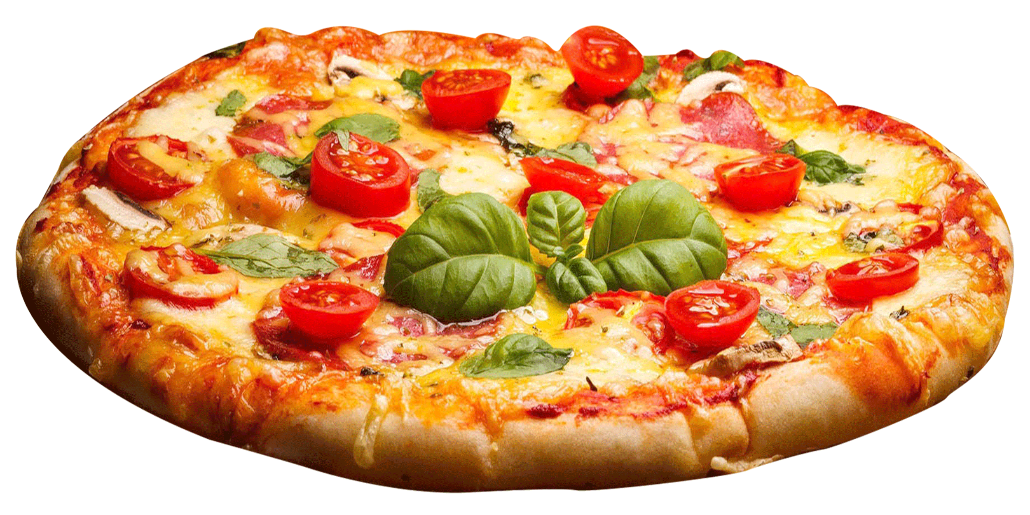
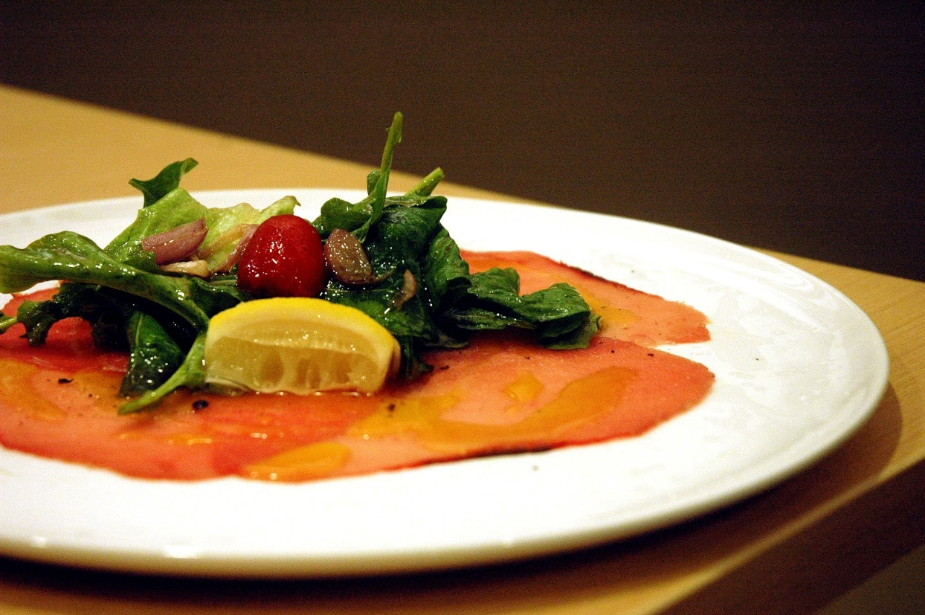
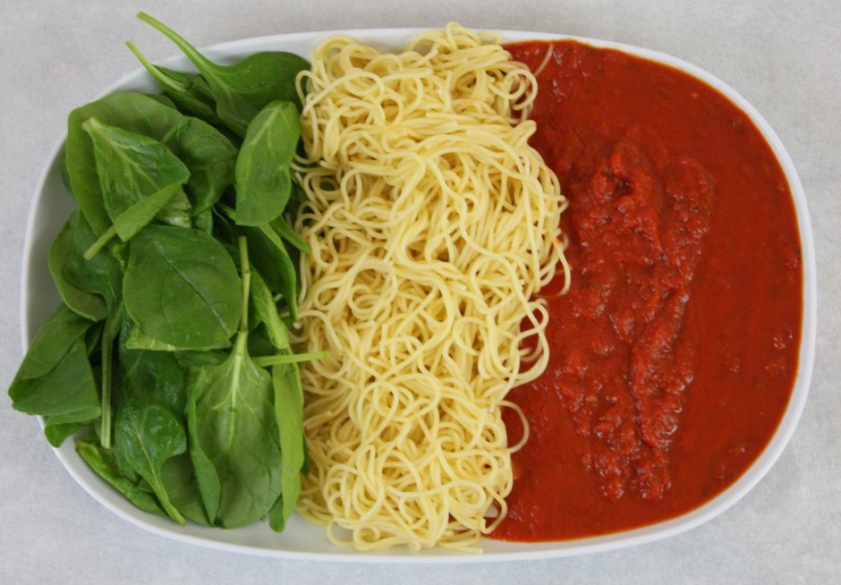
Italian food

Slide 5
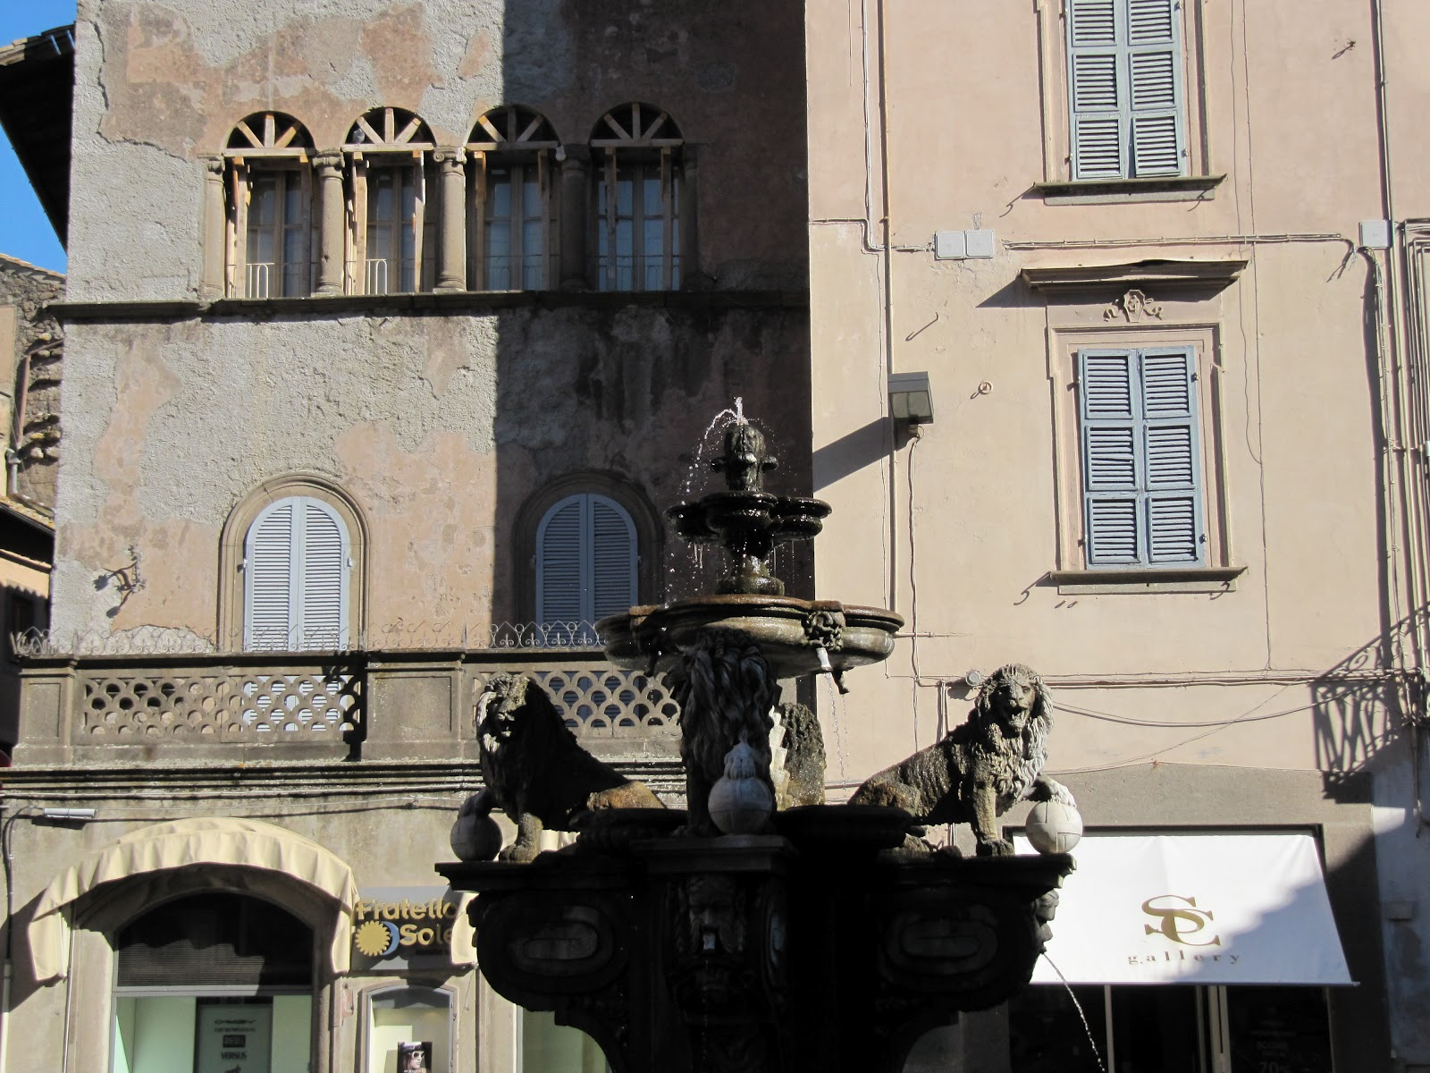
Quick fire facts!
Italy has many fountains 1 of which is a FREE wine fountain that works 24/7.
Italy was the first to make pizza and spaggeti
Bolineise
Italy has been making and eating this food 40 BC !

Slide 6
Italy quiz
Q’s
What is the capital of Italy?
What is the order for colours on the Italy flag?
How long does the free wine fountain last?
A’s
Bologna.
Green, white, red.
24/7 (24 hours 7 days a week).

