Slide 1

Year One
Phonics Screening Check
A Guide for Parents

Slide 2
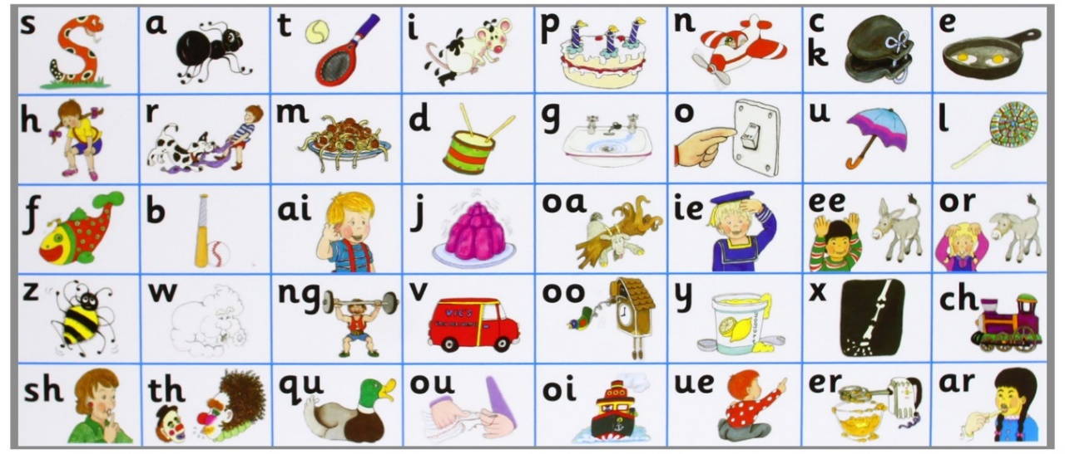
What is Phonics?
Your child began to learn phonics (sounds) in early years, both in nursery and reception. They began learning sounds, these sounds were used orally to identify and make words. If your child is in reception they are now using sounds from Phases 2 and 3 to read and spell words and children in Year 1 are also using Phase 5 sounds.

Slide 3
Phase 2
In Phase 2, letters and their sounds are introduced one at a time. A set of letters is taught each week, in the following sequence:
Set 1: s,a,t,p
Set 2: i,n,m,d
Set 3: g,o,c,k,
Set 4: ck,e,u,r
Set 5: h,b,f,ff,l,ll,ss

Slide 4
Phase 3
By the time they reach Phase 3, children will already be able to blend and segment words containing the 19 letters taught in Phase 2.
Over the twelve weeks which Phase 3 is expected to last, twenty-five new graphemes are introduced (one at a time).
Set 6: j, v, w, x
Set 7: y, z, zz, qu
Consonant digraphs: ch, sh, th, ng
Vowel digraphs: ai, ee, igh, oa, oo, ar, or, ur, ow, oi, ear, air, ure, er

Slide 5
Phase 4
In Phase 4, no new graphemes are introduced. The main aim of this phase is to consolidate the children's knowledge and to help them learn to read and spell words which have adjacent consonants, such as trap, string and milk.

Slide 6
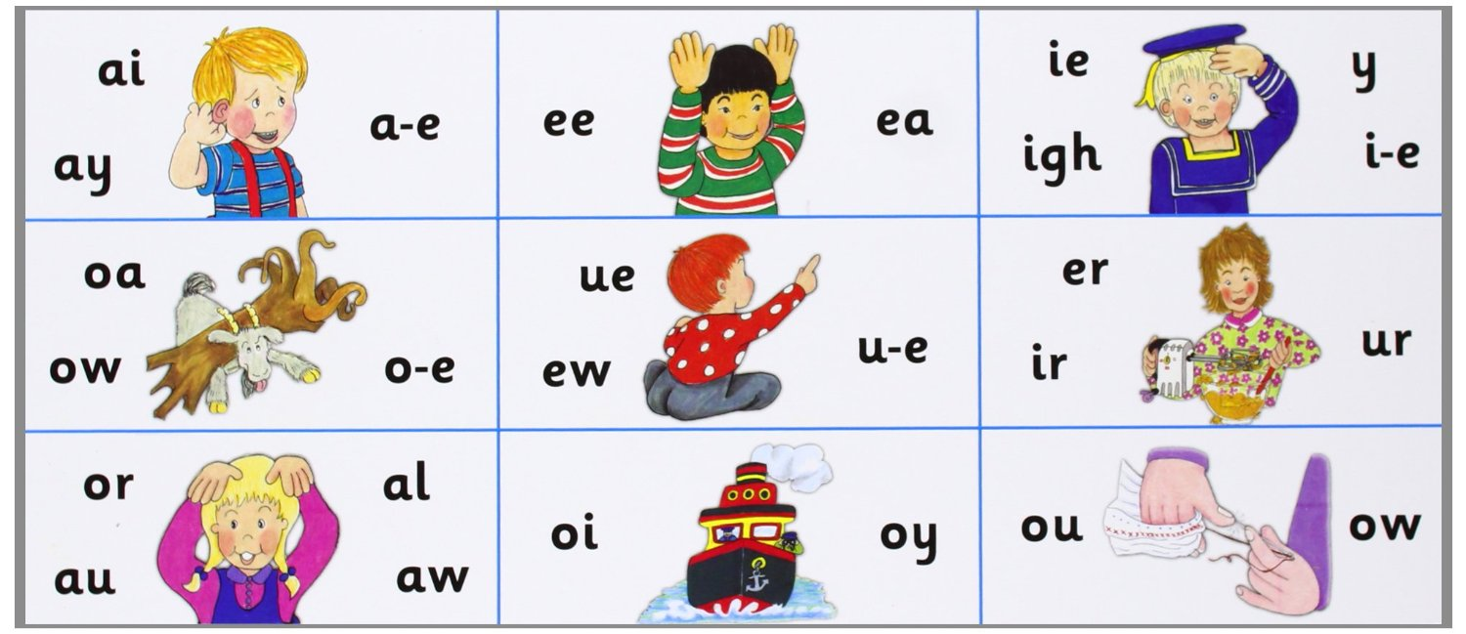
What is Phase 5?
In Phase Five, children will learn more graphemes and phonemes. For example, they already know ai as in rain, but now they will be introduced to ay as in day and a-e as in make.
Alternative pronunciations for graphemes will also be introduced, e.g. ea in tea, head and break.

Slide 7
Phonics
Phonics is taught daily in school using Active Learn. The children are taught to recognise the sounds that each individual letter makes; ▪identify the sounds that different combinations of letters make - such as ‘sh’ or ‘oo’; and ▪blend these sounds together from left to right to make a word. Children can then use this knowledge to ‘de-code’ new words that they hear or see.

Slide 8

Phonics

Slide 9
Phonics

Slide 10
What is the Phonics Screening Check?
Children in Year 1 throughout the country will all be taking part in a phonics screening check during the same week in June (week beginning 10th June). Children in Year 2 will also take the check if they did not achieve the required result when in Year 1 or they have not taken the test before.
The phonics screening check is designed to confirm whether individual children have learnt phonic decoding and blending skills to an appropriate standard.

Slide 11

What Happens During the Test?
The test contains 40 words. Each child will sit one-to-one and read each word aloud to their teacher. The test will take approximately 10 minutes per child, although all children are different and will complete the check at their own pace. The list of words the children read is a combination of 20 real words and 20 pseudo words (nonsense words).

Slide 12

Pseudo Words (Nonsense Words)
The pseudo words will be shown to your child with a picture of an alien. This provides the children with a context for the pseudo word which is independent from any existing vocabulary they may have. Pseudo words are included because they will be new to all pupils; they do not favour children with a good vocabulary knowledge or visual memory of words.

Slide 13

The Test

Slide 14
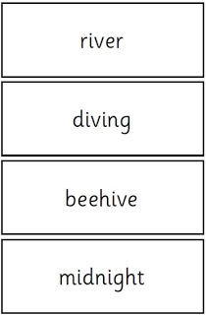
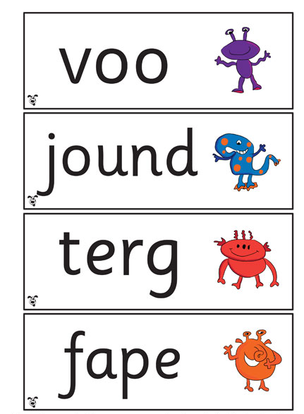
The Test

Slide 15
Reporting to Parents
By the end of the summer term school will report your child's results to you. We will also confirm if your child has met the standard threshold. In previous years this has been around 32/40 (80%). Children who do not achieve the expected level will retake the test when they are in Year 2.

Slide 16

How Are the Results Used?
Results from the check will be used by school to analyse their own performance and for Ofsted to use in inspections.

Slide 17
How Can I Help My Child at Home?
Play lots of sound and listening games with your child.
Read as much as possible to and with your child.
Encourage and praise – get them to have a ‘good guess’.
If your child is struggling to decode a word, help them by encouraging them to say each sound in the word from left to right.
Blend the sounds by pointing to each one, e.g. /c/ in cat, /p/ in pat, /ng/ in sing, /ee/ in been. Next move your finger under the whole word as you say it.
Discuss the meaning of words if your child does not
know what they have read.

Slide 18
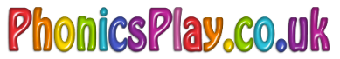
How Can I Help My Child at Home?
A Useful Website:
There are some free games on Phonics Play which can help your child however you can pay for a subscription which is £12 per year which will enable you to have access to a wider variety of activities.

Slide 19
Thank You!

