Slide 1




Before you get started
Parents: read our helpful guidance before you get started
Growing and Changing
Home-leaning Lesson 1: Physical changes during puberty
To start, play this slideshow from beginning

Slide 2
Parents — Home-learning about puberty:
When learning about puberty in schools, we recommend that pupils are taught in mixed groups so all young people learn about changes to both male and female bodies.
We continue to recommend that young people continue to learn about changes to both male and female bodies while learning at home.
Please ensure that young people following this powerpoint are guided to complete all activities.

Slide 3

Home-learning lesson 1: Physical changes during puberty

Slide 4



      We are learning about some of the physical changes that happen during puberty
  We will be able to:
  identify some of the external and internal changes that happen to bodies during puberty.
  explain what happens during menstruation (periods).
  explain what is meant by ejaculation and wet dreams.

Slide 5



Growing and changing.
What’s our starting point?
Draw a person about the same age as you.
Think about the changes that will happen to that person as they become a teenager.
Write the changes around your picture.
Keep this safe for later! We’ll come back to it at the end of the session.

Slide 6
True or false?
Read the statements below and decide if you think they are true or false.
Click on the statement to reveal the correct answer.
True
During puberty the body grows quickly. It is caused by changes in something called hormones. These are chemicals that send messages around the body.
Puberty is when a person’s body changes from being a child to being an adult.
False
Puberty starts at different times between ages 8 and 13 in females, and ages 9 and 15 in males. It starts when the body is ready, a bit like losing your milk teeth.
Puberty starts at the same time for everyone.
Notes:
Puberty is when a person’s body changes from being a child to being an adult. → True During puberty the body grows quickly. It is caused by changes in something called hormones. These are chemicals that send messages around the body.
Puberty starts at the same time for everyone. → False Puberty starts at different times between ages 8 and 13 in females, and ages 9 and 15 in males. It starts when the body is ready, a bit like losing your milk teeth.

Slide 7
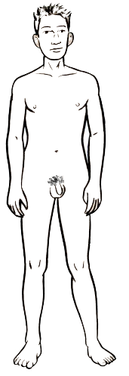
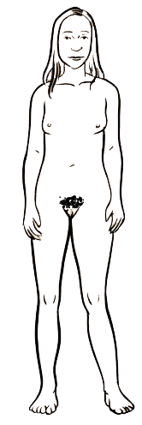
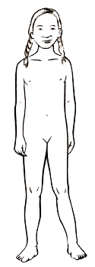
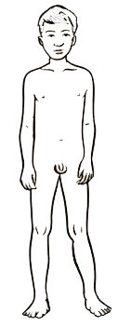
The changing body
With a parent or someone at home, talk about what changes the body might go through as a person gets older.
Males:
Females:
Muscle increases
Penis and testicles grow
Grow pubic hair
Grow taller
Get spots and sweat more
Get oilier skin and hair
Get a deeper voice
Grow breasts
Hips and waist change shape
Grow pubic hair
Grow taller
Get spots and sweat more
Get oilier skin and hair
Get a deeper voice
Images ©Family Planning Association NZ

Slide 8
Parts of the body
When we talk about parts of the body, we sometimes use special words with our families, everyday slang words or scientific words.
This can make it confusing to figure out if we mean the same thing. We are going to use scientific words to describe body parts.
How many parts can you name in the pictures below?
nipple
hips
penis
chest
vulva
(internally - vagina)
stomach
legs
testicles
Click each part to reveal the correct names

Slide 9
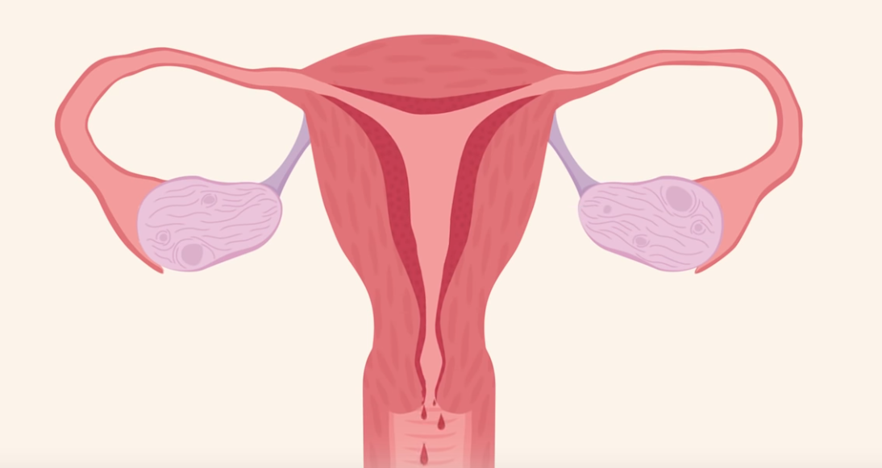
Alex has overheard their older sister talking to her parents.
Can you pick something up for me from the shop? I’ve started my period.
What do you think is happening to Alex’s sister?
Write down your answer, or discuss this with a parent.
Alex’s sister is starting her period, this is a change that happens during puberty.
A period is when females pass blood from the vagina for a few days each month.
The scientific name for this is menstruation.
Periods can start at different ages for different people.
Click on this picture to watch a video explaining more →
about periods.
Notes:
Link to video: https://www.youtube.com/watch?v=vXrQ_FhZmos

Slide 10
Can you name any of the parts of the female body below using the word bank? Click on each picture to reveal the answers
fallopian tube
Word bank
anus
cervix
clitoris
fallopian tube
ovary
pubic hair
urethra
uterus
vagina
vulva
uterus
pubic hair
clitoris
urethra
cervix
ovary
vagina
vagina
vulva
anus
Internal parts
External parts

Slide 11
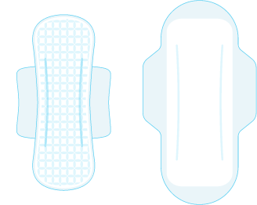
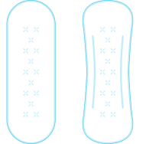
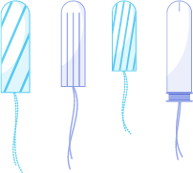

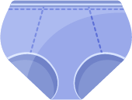
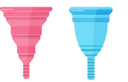
Clara is in Year 7. Can you think of any products she might use to help manage her periods?
Clara could use a pad.
These come in different shapes and sizes and are worn outside the body. Some are reusable and can be washed. Others are disposable.
Clara could use a tampon.
These come in different shapes and sizes. Sometimes they have applicators, and they are worn inside the vagina. They need to be removed and disposed of regularly.
Clara could use a period pants.
These are absorbent and are worn like normal underwear. They can be washed and reused.
Clara could use a menstrual cup.
These are worn inside the vagina to catch blood and can be emptied and reused.

Slide 12
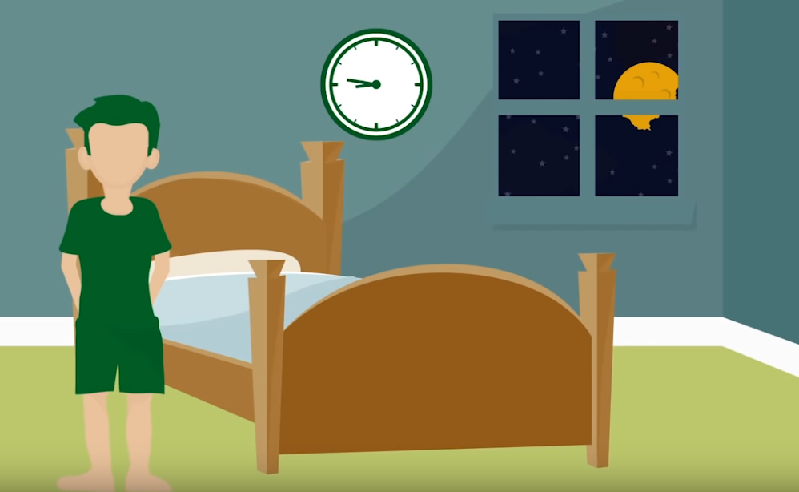
Read Zach’s story below:
Zach woke up one morning to find that his PJ trousers were sticky and wet. He was confused and a little embarrassed — for a moment he was worried he’d wet himself.
What do you think has happened to Zach?
Write down your answer, or discuss this with a parent.
Zach has had a wet dream.
A wet dream is what happens when the penis becomes erect and ejaculates. This means that semen, which contains sperm cells, has been released from the penis. This is a normal part of puberty for males and is nothing to be embarrassed about.
Click on this picture to watch a video explaining more →
about wet dreams.
Notes:
Link to video: https://www.youtube.com/watch?v=RJtbLfJ_kRk

Slide 13
Can you name any of the parts of the male body below using the word bank? Click on the picture to reveal the answers
bladder
Word bank
anus
bladder
epididymis
foreskin
penis
scrotum
testicle
urethra
epididymis
penis
foreskin
anus
testicle
scrotum
urethra
© PSHE Association 2020

Slide 14
What do you think?
Read the questions below and discuss or write down what you think.
Click each statement to reveal the answers.
If a person wants to, they can go swimming on their period. They will need to use a tampon or menstrual cup to while they swim.
Can a person go swimming on their period?
Do periods always hurt?
Sometimes periods can make a person’s tummy or back hurt. However for some people they don’t cause any aches or pains.
Wet dreams are a normal part of growing up but some people may not experience them.
When a person grows body hair during puberty, they may choose to remove it, but this is a choice for each person to make.
Do all boys have wet dreams?
Does a person who is going through puberty have to shave?
Notes:
Can a person go swimming on their period?
If a person wants to, they can go swimming on their period. They will need to use a tampon or menstrual cup to while they swim.
Do periods always hurt?
Sometimes periods can make a person’s tummy or back hurt. However for some people they don’t cause any aches or pains.
Do all boys have wet dreams?
Wet dreams are a normal part of growing up but some people may not experience them.
Does a person who is going through puberty have to shave?
When a person grows body hair during puberty, they may choose to remove it, but this is a choice for each person to make.

Slide 15

Growing and changing.
Where are you now?
Look back at your picture of a person about your age from when we began learning about puberty in this session.
Can you add to or change anything that you have written around the person, about the changes that might happen to them as they grow up?

Slide 16
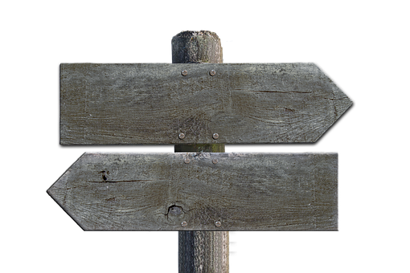
Remember!
If you feel worried about puberty or what you have learned during this session, talking to an adult you trust is one of the best ways to find help.
If you want to talk to someone other than a parent:
ChildLine can help.
See: https://www.childline.org.uk/get-support/
Or phone 0800 1111
Talk to a trusted adult at home
ChildLine: www.childline.org.uk
0800 1111

