Slide 1




Before you get started
Parents: read our helpful guidance before you get started
Growing and Changing
Home-leaning Lesson 2:
Managing puberty — Emotions and hygiene
To start, play this slideshow from beginning

Slide 2
Parents – Home-learning about puberty:
When learning about puberty in schools, we recommend that pupils are taught in mixed groups so all children and young people learn about changes to both male and female bodies.
We continue to recommend that young people learn about changes to both male and female bodies while learning at home.
Please ensure that young people following this powerpoint are guided to complete all activities.

Slide 3

Home-learning lesson 2: Managing puberty – Emotions and hygiene

Slide 4



      We are learning about how to manage feelings and hygiene during puberty.
  We will be able to:
  describe ways of managing physical changes during puberty, including how and why it is important to keep clean.
  describe how emotions and relationships may change during puberty.
  explain how and when to get help and support in relation to puberty.

Slide 5

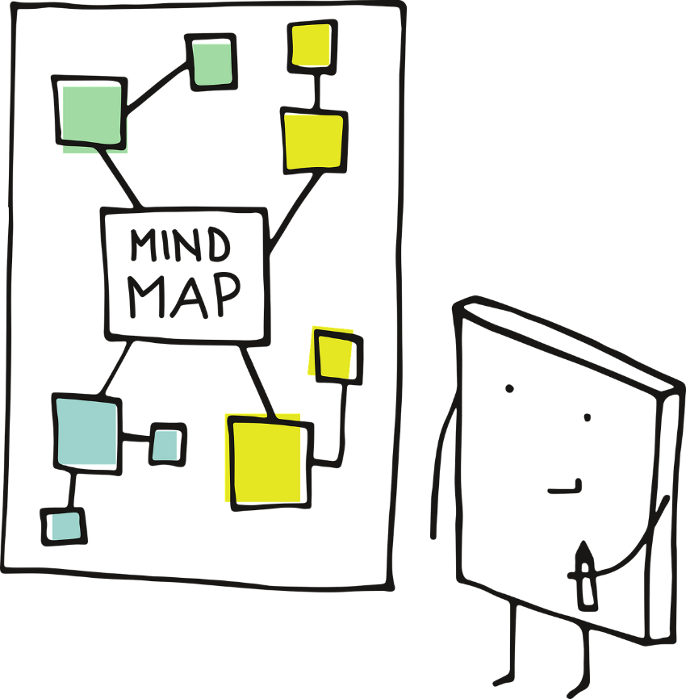

Growing and changing
What’s our starting point?
Imagine a young person about your age or a little older. They are going through puberty.
  What might they find difficult about puberty?
  What might they do to manage these challenges?
Draw a mind map and try to include as many answers to the two questions above as you can.

Slide 6

What body parts do you think someone going through puberty might need to pay special attention to while keeping clean?
Draw a person and write your answers around them, or discuss with a parent.
Hair
During puberty hair can get oilier.
Washing hair with warm water and a small amount of shampoo can help to control oil.
Skin and spots
Skin also gets oilier during puberty. Sometimes this oil traps dirt or germs. While they can be upsetting and embarrassing, they are a normal part of puberty. Everyone will get them at some point in their life, it doesn’t mean they have poor hygiene!
Washing genitals
The vulva: Washing the outside part of the vulva with an unperfumed soap every day can help to keep it clean. The inside of the vagina can clean itself and this does not need washing, and cleaning inside can cause irritation.
The penis: Gently washing the penis with warm water and soap each day keeps it clean. If the penis has a foreskin, this should be gently pulled back and washed underneath. This prevents the build up of too much smegma, a cheesy-looking substance that can start to smell and build up bacteria.
Sweat and body odour
During puberty sweat glands become more active than before and sweat can smell stronger.
Showering or bathing everyday using warm water and a mild soap or shower gel can help keep the smell and bacteria under control. Wearing clean clothing can also help to keep clean.
Deodorants cover up the smell of body odour and anti-perspirants reduce sweating.

Slide 7
How often should a person do each of the activities below?
Write each activity under one of the time headings, or discuss with a parent.
Click each of the headings to reveal answers.
Activities
Washing hair
Brushing hair
Brushing teeth
Showering or bathing
Putting on deodorant
Changing underwear
Washing PE kit
Wash day-to-day clothes
Every day
Every day:
Brush hair, brush teeth twice in a day, put on deodorant and change underwear. Shower if the person exercised that day.
A few times a week
A few times a week:
Shower or have a bath, wash hair (may be more or less depending on how oily a person’s hair is) and wash clothes.
Once a week
Once a week:
Wash PE kit (or more often if you do PE on more than one day) or outerwear such as school jumpers.
Notes:
Every day
Brush hair, brush teeth twice in a day, put on deodorant and change underwear. Shower if the person exercised that day.
A few times a week
Shower or have a bath, wash hair (may be more or less depending on how oily a person’s hair is) and wash clothes.
Once a week
Wash PE kit (or more often if you do PE on more than one day) or outerwear such as school jumpers.

Slide 8



Feelings and emotions
Hormones, which are special chemicals in the body, change the body’s physical appearance. They can also affect how people’s emotions.
On a piece of paper, write out different emotions or feelings someone might have during puberty.
Once you have done this, cut these out so that each feeling is on a separate piece of paper.
Happy
Sad
Fed up

Slide 9



An emotional rollercoaster
On a new piece of paper, draw a wavy line like the one below.
Sometimes feelings can change quickly during puberty, one minute a person can feel really happy (or up) and the next they can feel really sad (or low.)
Arrange the emotions and feelings you wrote out earlier on the line. Which feelings are high up? Which feelings are low down? Are there any somewhere in the middle?
How could someone manage the low feelings to help themselves feel better?
Happy
Fed up
Sad

Slide 10


New feelings towards others
What do you think emojis like the ones below represent?
Sometimes, as a person goes through puberty, they may develop new feelings for another person that they haven’t felt before. They might have a ‘crush.’
A person with a crush might feel a tingly feeling, or they might feel like another person makes them really happy. Sometimes it can feel very intense or overwhelming.
A person could have a crush on someone they know, or someone they don’t, like a celebrity. It could be towards someone of the same or opposite sex.
Crushes are a natural part of growing up.

Slide 11
Sometimes a person might need help and support to manage their feelings during puberty.
Which of the options below do you think would be most helpful to manage each of the situations?
Options:
Situations:
A
Talking to a friend
Talking to a family member
Visiting childline for advice, and using services such as ‘Ask Sam’ on their website
Reading a book about it
Doing nothing
Something else (if you have any other ideas, discuss these with a parent or someone at home)
Cameron keeps feeling really angry about little things. She shouted at her mum and now she’s upset.
B
Devan is worried about the changes that might happen to their body.
C
Lando had a crush and told everyone about it. He doesn’t feel the same way anymore and feels a bit embarrassed.

Slide 12

Growing and changing.
Where are you now?
Look back at your mind map from the start of the session.
Can you add to or change anything that you have written about managing the challenges a person might experience during puberty?

Slide 13

Remember!
If you feel worried about puberty or what you have learned during this session, talking to an adult you trust is one of the best ways to find help.
If you want to talk to someone other than a parent:
ChildLine can help. See:
https://www.childline.org.uk/get-support/ or phone 0800 1111
Talk to a trusted adult at home
ChildLine: www.childline.org.uk
0800 1111

Slide 14

Optional extension
Build a puberty toolkit
Create an advice sheet for other young people to help them manage their emotions and physical wellbeing through puberty.
You might want to consider:
How to manage physical changes to the body.
How to manage emotional changes.
Where to get help and support.

