Slide 1

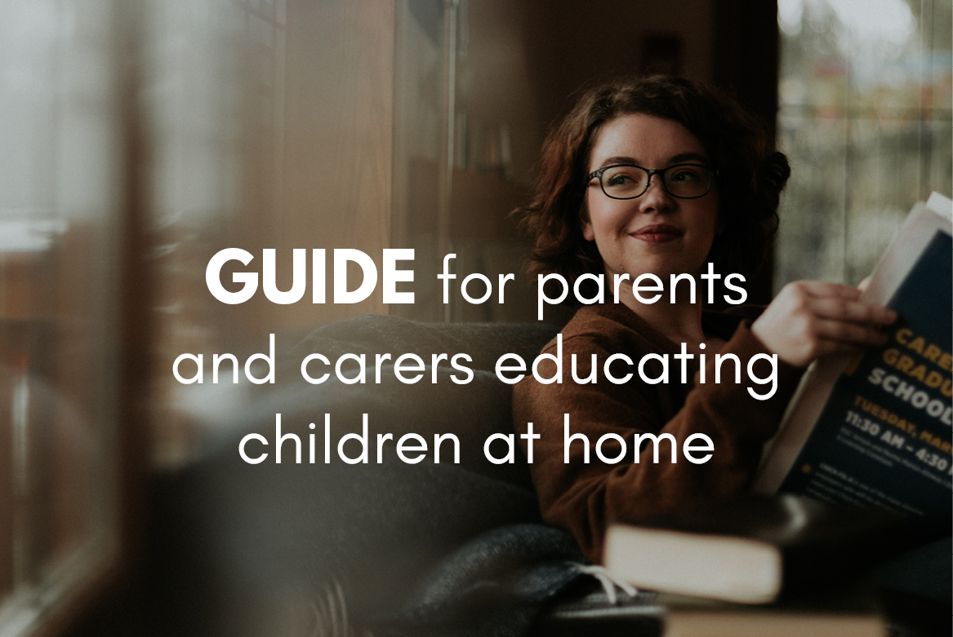


Before you get started
Parents: read our helpful guidance before you get started
Growing and Changing
Year 6/7 Home-learning:
Managing changes during puberty
To start, play this slideshow from beginning

Slide 2
Parents and teachers: Home-learning about puberty
When learning about puberty in schools, we recommend that pupils are taught in mixed groups so all young people learn about changes to both male and female bodies.
We continue to recommend that young people learn about changes to both male and female bodies while learning at home.
Please ensure that young people following this powerpoint are guided to complete all activities.

Slide 3

Year 6/7 Home-learning Managing changes during puberty

Slide 4



      We are learning about how to manage the changes that happen during puberty.
  We will be able to:
  describe the physical and emotional changes during puberty and how to manage these.
  identify myths and facts about puberty.
  demonstrate how to begin conversations or ask questions about puberty with people who can help us.

Slide 5



Growing and changing
What’s our starting point?
On a piece of paper, make a graffiti board with all the words you can think of that relate to growing up and puberty.
You might also like to include some words that describe how people might feel about puberty and growing up.
Keep this safe — we will be coming back to it at the end of the session.

Slide 6
Quick questions about puberty
Click each card to reveal the answers
Everyone experiences puberty. Young people, male and female, as they grow into adults will experience puberty.
Though this can start at different times for each person.
Who experiences puberty?
Puberty starts at different times for different people, and it starts when the body is ready.
For girls this is usually between ages 8 and 13. For boys this is usually between ages 9 and 15.
Puberty may continue into the early 20s.
When do they experience puberty?
Puberty is the process through which the body changes from that of a child to an adult.
This change is caused by changing hormones, which are special chemicals in the body.
What is puberty?
Notes:
Who experiences puberty?
Everyone experiences puberty. Young people, male and female, as they grow into adults will experience puberty.
Though this can start at different times for each person.
When do they experience puberty?
Puberty starts at different times for different people, and it starts when the body is ready.
For girls this is usually between ages 8 and 13. For boys this is usually between ages 9 and 15.
Puberty may continue into the early 20s.
What is puberty?
Puberty is the process through which the body changes from that of a child to an adult.
This change is caused by changing hormones, which are special chemicals in the body.

Slide 7
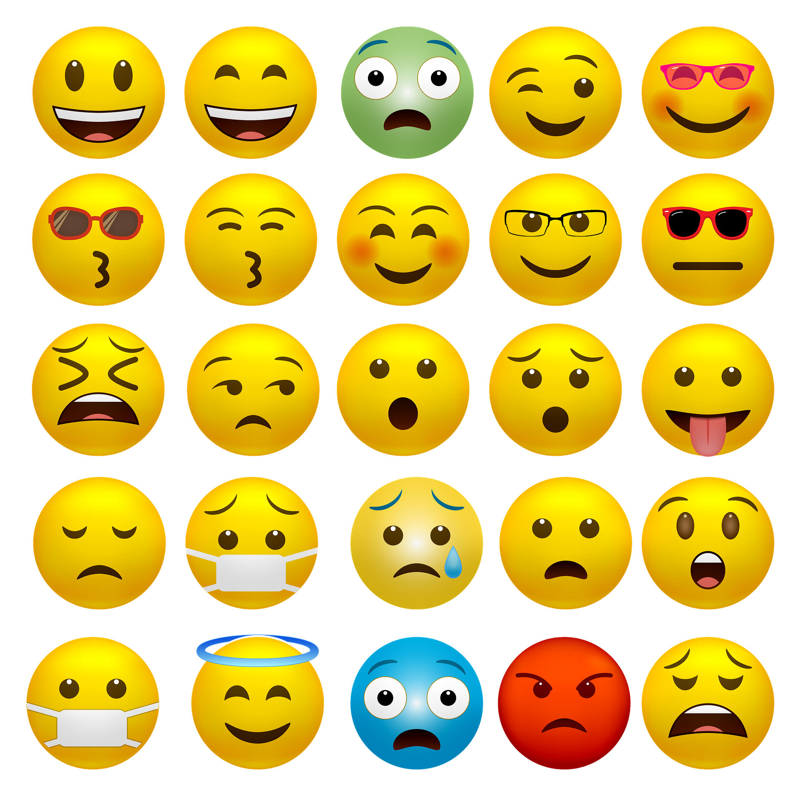
Fact or myth?
Click on only the facts while avoiding the myths, can you find all six facts?
Everybody starts puberty at the same time, around age eight.
Pubic hair grows during puberty.
People’s body shape changes when they go through puberty.
Everyone gets tummy ache when they get their period.
Oops! That’s a myth.
Well done! That’s a fact.
It’s normal to have mood swings and feel different, strong emotions during puberty.
The size of a person’s breasts or penis is determined during puberty.
Puberty causes people to sweat more.
Voices get deeper during puberty.
Squeezing spots will make them go away.
Pads are the only product available for use during periods.
Puberty is a natural part of growing up and the human life cycle.
Notes:
Facts:
Pubic hair grows during puberty.
People’s body shape changes when they go through puberty.
It’s normal to have mood swings and feel different, strong emotions during puberty.
Puberty causes people to sweat more.
Voices get deeper during puberty.
Puberty is a natural part of growing up and the human life cycle.
Myths are on the next slide with further detail.

Slide 8
Clicked too far and left the game too early?
Just press the ← direction key on your laptop or swipe back on your phone or tablet to continue!
Puberty myths
“Everybody starts puberty at the same time.”
Young people begin puberty at different ages, as discussed earlier in the session.
“Everyone gets tummy ache when they get their period.”
Some people experience aches or pains, but it doesn’t happen to everyone.
“Pads are the only available product for use during a period.”
There are lots of products that can be used to help manage periods.
For example: Tampons, menstrual cups or period pants. It’s all down to personal preference.
“Squeezing spots will help them to go away.”
Most people will experience spots at some point in their lives. Squeezing them doesn’t help them go away and may spread bacteria!
Having spots does not mean someone has poor hygiene.
“The size of a person’s breasts and penis is determined during puberty.”
People keep growing and changing over their lives, young people are still growing so it is not possible to know what they will look like as an adult.

Slide 9
Zones of relevance
Not at all
On a piece of paper, draw three circles like the ones in the diagram.
Write each of the statements below in the circle that shows how important you think this information is for a young person to know during puberty.
Less
Most
How to talk to parents about puberty | How often to wash their hair | When their friends grow pubic hair | How to use a menstrual pad
How to use tampons or other products | How to manage a wet dream | What type of bra to buy | How it feels to fancy someone
Who to ask questions about puberty | Which books or websites about puberty are best | How to shave | Who their friends fancy
How to apply make-up | Which products would help with spots | The best type of deodorant | How to help a friend who’s a bit embarrassed
Bear in mind that friends may not want to share information about who they fancy or about what changes have happened to them.
It’s important to be kind and respect their privacy.

Slide 10
Planning a conversation
Choose two or three of the most important points from your zones of relevance activity.
If a young person wanted to talk to a friend or parent, what might they say?
Write the first sentence or question a young person use to open the conversation.
For example:
Challenge
Write out the conversation as a script, imagining what the parent or friend might say.
Mum, I’ve been wanting to talk to you about getting a bra. Can you help me choose which one would be best for me?

Slide 11
Growing and changing
Where are you now?
Look back at your graffiti board.
Can you add or change anything about puberty and growing up?
Finish these sentences or discuss with a parent:
  Something I didn’t realise before this session is…
  Something I knew but had forgotten is…
  Something I would like to know more about is…

Slide 12

Remember!
If you feel worried about puberty or what you have learned during this session, talking to an adult you trust is one of the best ways to find help.
If you want to talk to someone other than a parent:
ChildLine can help.
See:https://www.childline.org.uk/get-support/
Or phone 0800 1111
Talk to a trusted adult at home
ChildLine: www.childline.org.uk
0800 1111

