Slide 1
Physical education and healthy eating

Slide 2
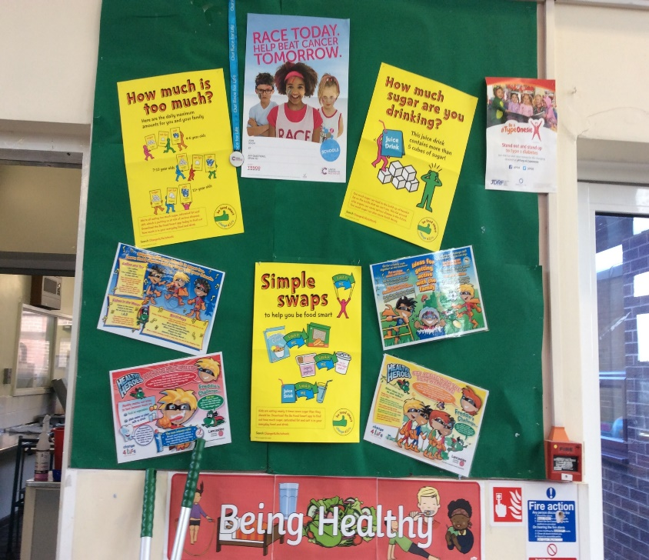
Stay healthy
St Peters have improved so much in the the past year!
We have a healthy eating board and health champions
We also have a healthy eating policy

Slide 3
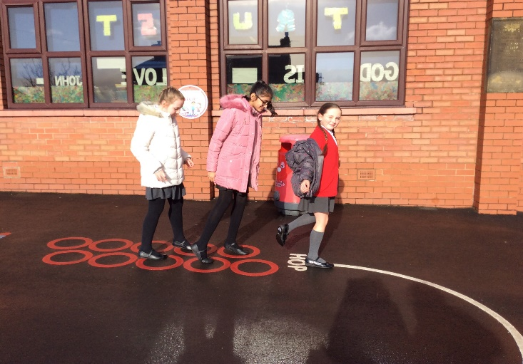
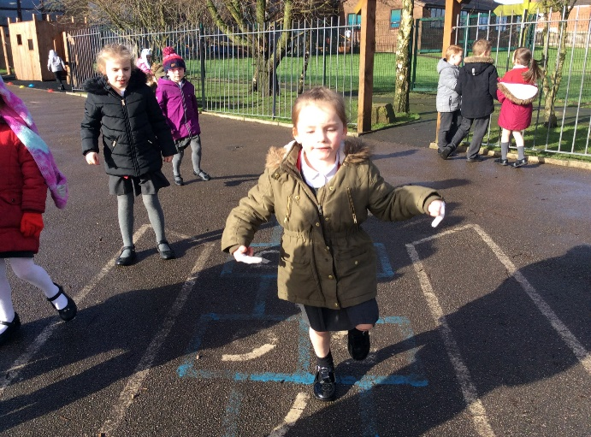
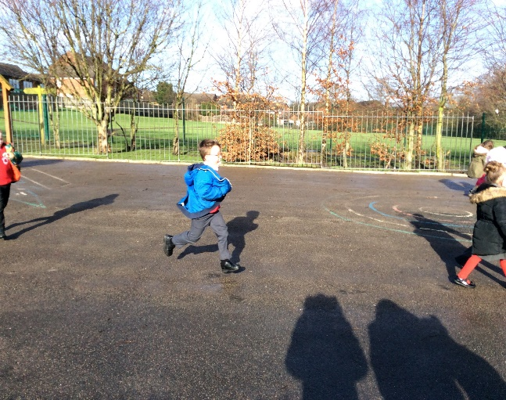
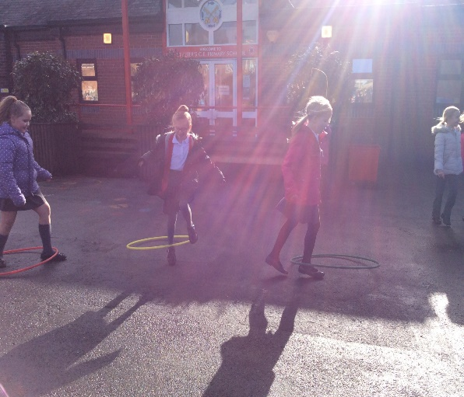
Playground marking
Hop scotch
Safely running around
Playing with equipment
Here are some people staying fit whilst having FUN!!!

Slide 4
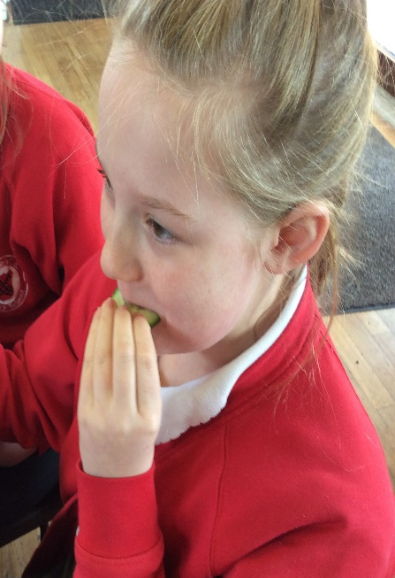
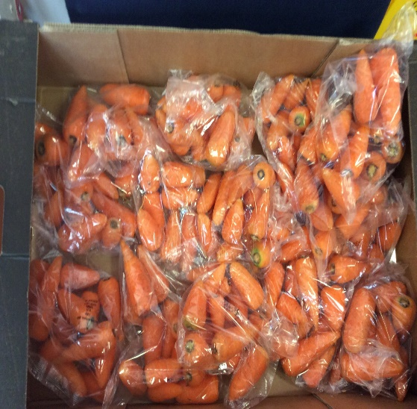
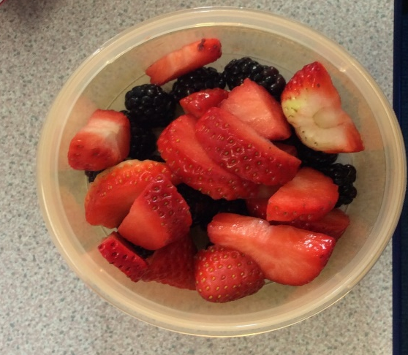
Healthy foods
Tomatoes
Peaches
Kiwi
Carrots
Apples
Pears
Strawberries
Cucumbers
( FRUIT AND VEG )

Slide 5
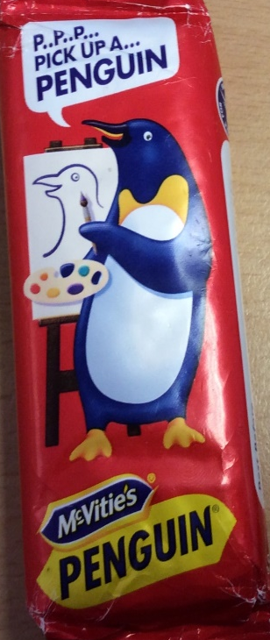
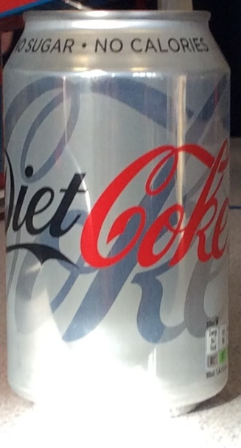
Treat Friday
WHAT IS TREAT FRIDAY
Treat Friday is when you bring a chocolate treat or sweets but no fizzy drinks on Friday.
So people can have a treat but only once a week.
We changed the healthy eating policy to ensure
People on pack lunches are have a healthy meal

Slide 6

Happy Birthday!
When it is our birthday, we buy our class a book rather than give sweets or cakes.

Slide 7
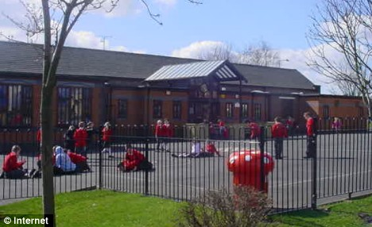
Play leaders go out at lunchtime to play games with the infant children.

Slide 8
We have lots more after school clubs
Like …
Hockey
like …
Dodgeball
Dance
High five
Football
Multi- Skills
And preparing for more
Taekwondo
Geocaching

Slide 9
Everyone is encouraged to take part in physical activity no matter what their ability.

Slide 10
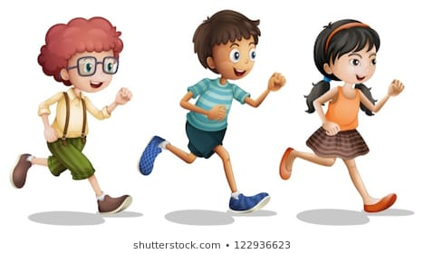
Mile a day
All children run or walk around our new running track every day in order to complete our mile a day challenge. It is great fun and everyone has improved their fitness level.

Slide 11
By Cerys, Toni and Isabel

