Slide 1
Daily Peer Massage Routine

Slide 2
Daily Massage Routine
Ask permission to touch your partner

Slide 3
Breathing
Hands on shoulders, breathe in through your nose, out through your mouth x 3

Slide 4
baker / kneading
Place hands on shoulders and make gentle squeezing movements with the palm and fingers.

Slide 5
hearts x 3
Begin at the base of the spine, with one hand either side of the spine.
Move the hands upward making a small heart- shaped formation, and coming back down to the base of the spine. Continue making a larger and a larger heart shaped formations.

Slide 6
Place the fingers on the forehead and stroke around to the side. Hold the head for a couple of seconds.

Slide 7
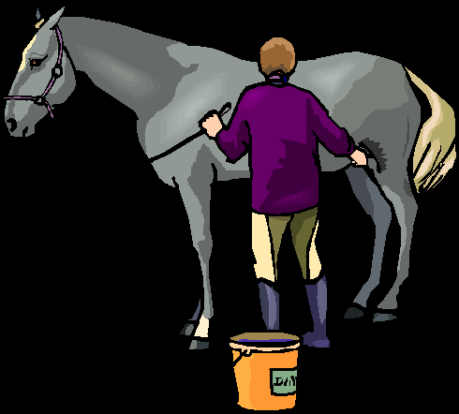
brushing the horse x 3
Stroke with one flat hand at a time from the neck down the centre of the back.

Slide 8
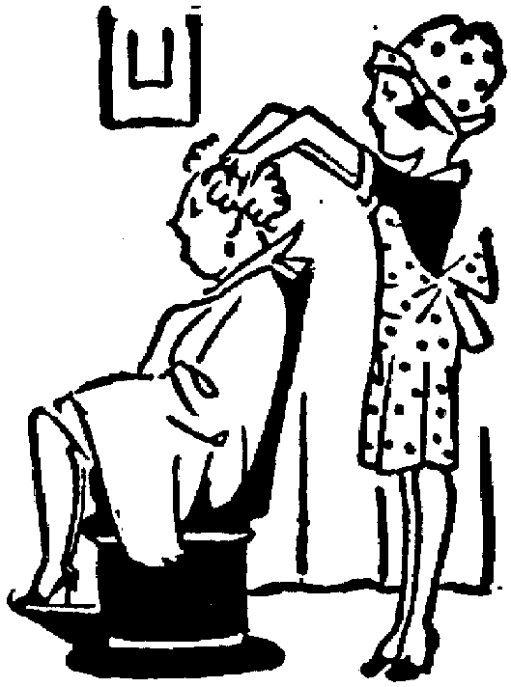
Hairdresser
Place fingers on top of hair, make circles with fingertips.

Slide 9
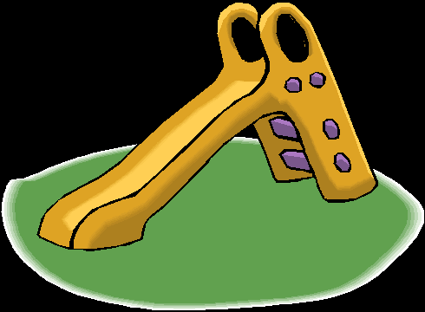
sliding board x 3
Stroke from the top of the head down the neck and over the shoulders.

Slide 10

brushing off the snow x3
Stroke rather quickly out from the spine, down the back from shoulders to hip.

Slide 11
Breathing
Hands on shoulders, breathe in through your nose, out through your mouth x 3

Slide 12
Everyone say
‘thank you’
to each other.

