Slide 1
PSHE
October 2023

Slide 2

What is PSHE?

Slide 3
We have PSHE and RE lessons each week in school but, do we know what the initials stand for?

Slide 4
P
S
H
E
R
E
Personal
Social
Health
Economic
Relationships
Education

Slide 5
What do we teach in PSHE?
Our learning falls into 3 categories
1. Health and Wellbeing
2. Relationships
3. Living in the Wider World

Slide 6
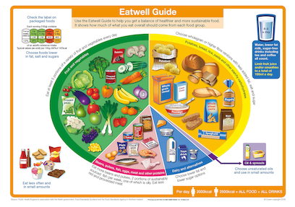
What do we learn about in these areas?
Health and Well-Being:
Healthy lifestyles eg a balanced diet and exercise
Our feelings – how to recognise and manage them
Recognising our strengths and skills
Treating others with respect
Growing up
How to keep safe – at home, in school and in our community
Recognising and managing risks

Slide 7
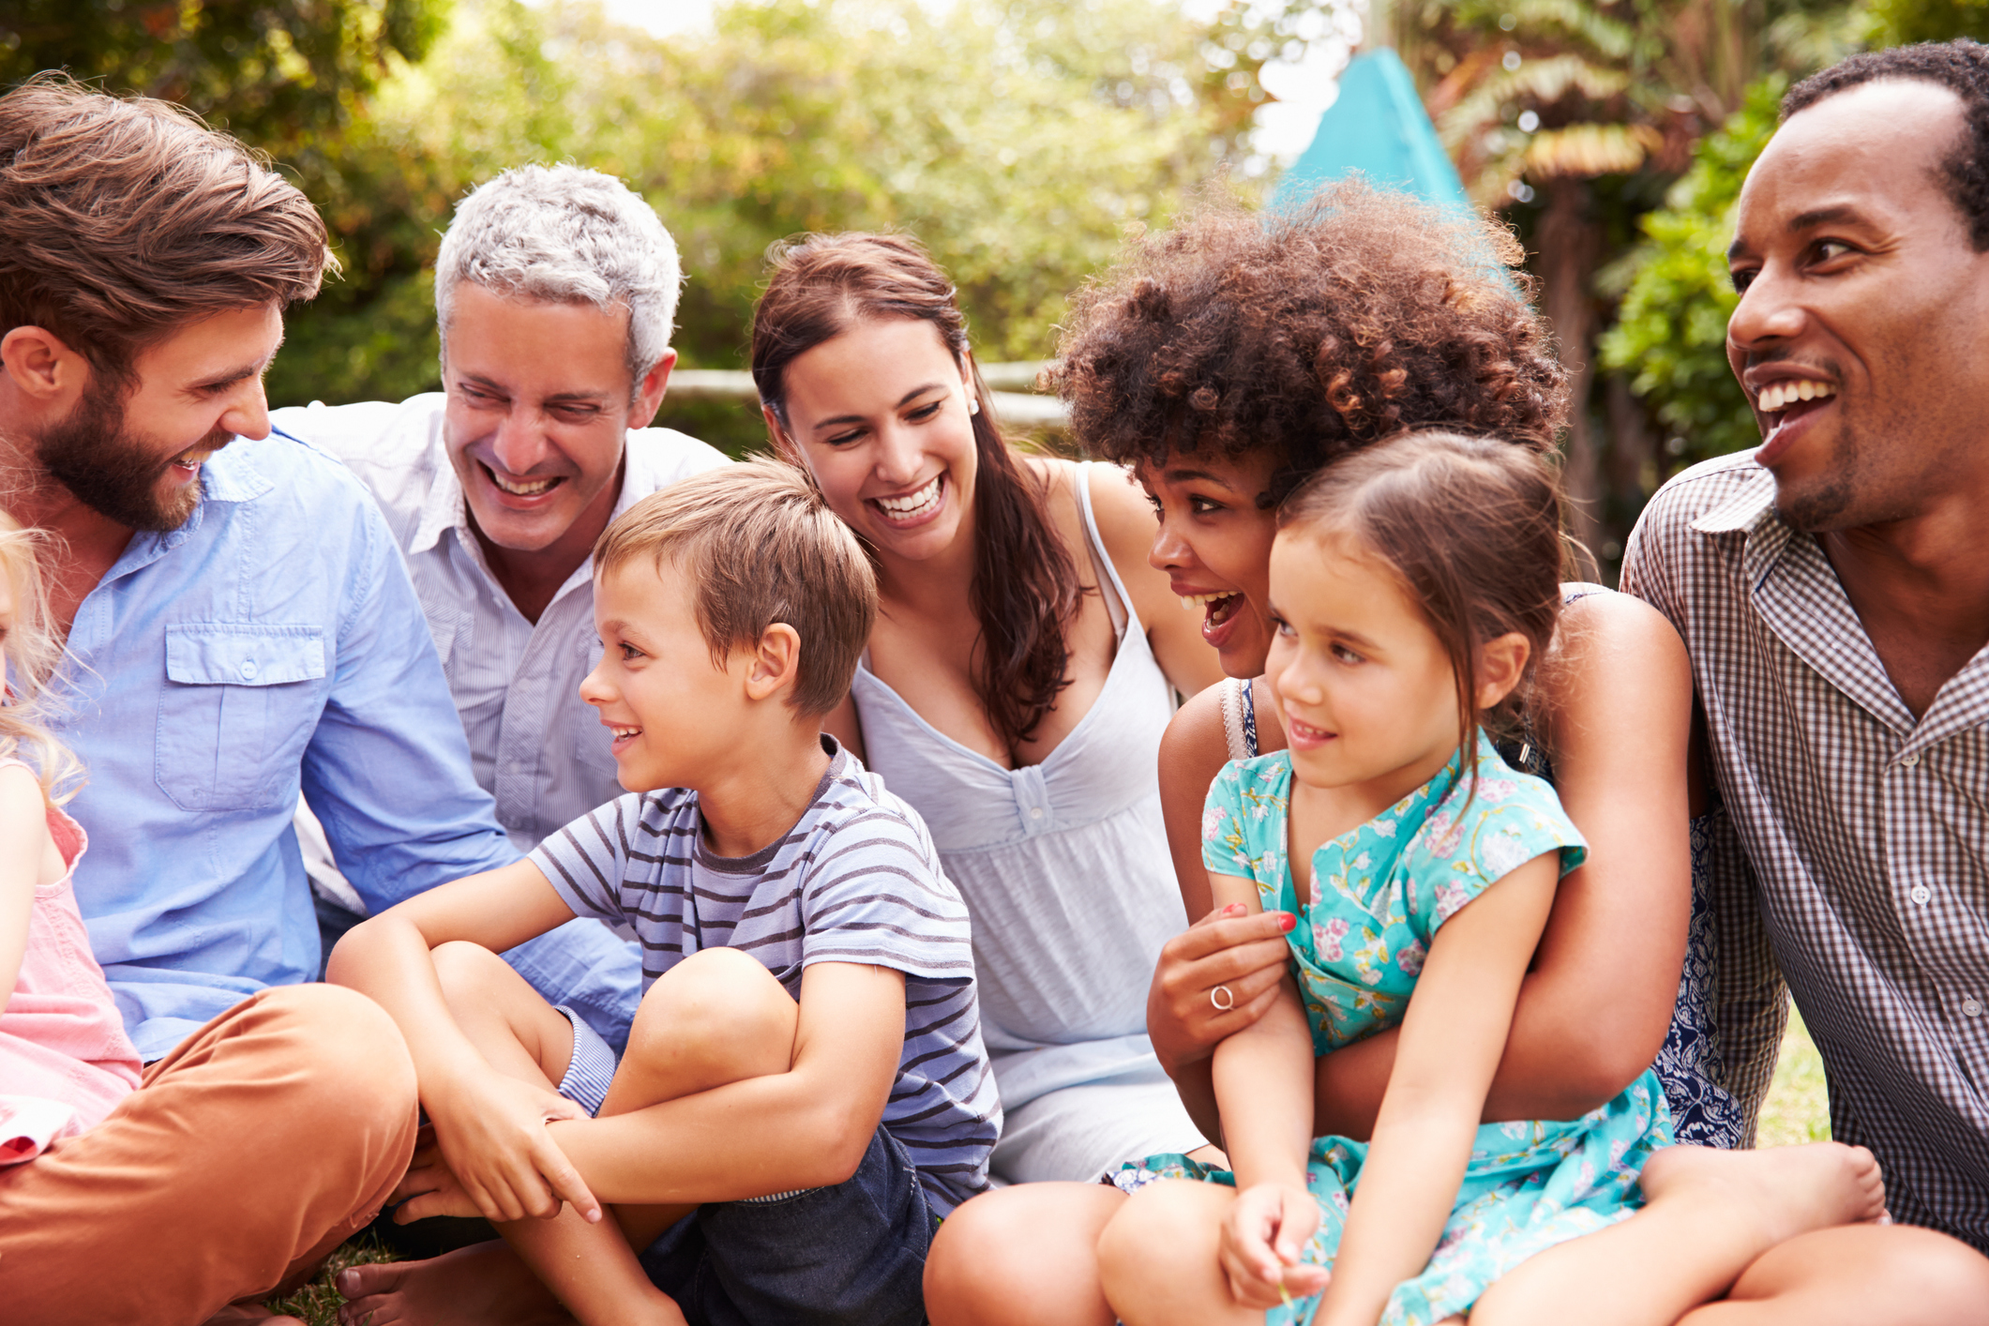

Relationships:
Anti-bullying
How to be a good friend
How to treat others with respect
Changes in our lives and how we become independent
Relationships with other people such as family and friends

Slide 8

Living in the Wider World:
Money matters
Job / career aspirations
How the media influences us
How we can make a difference to others and our environment

Slide 9
Why do we teach PSHE?
The government has made PSHE and RE statutory which means that we have got to teach this subject in school every week.
Your teachers agree and believe that PSHE helps create a safe school community in which you, our pupils can grow, learn and develop positive, healthy behaviour for life.
We are learning important life skills which you will be able to continue to use in the future .

Slide 10

Name Change!
Although we teach PSHE regularly in school, many children don’t realise this and very often don’t understand what PSHE means. Our school governors get confused too.
To make PSHE easier for everyone to understand, we are going to change the name to
Learning for Life or L4L

Slide 11

Competition time!!
We would like you to design a symbol / logo for Learning for Life or L4L to show the skills that we learn in our lessons. Think about the topics that are taught and try to incorporate them into your design.
This design will then be added to a mascot for each classroom to help us with our Learning for Life lessons.
There will be 3 runner up prizes and one overall winner.

Slide 12

Please return all entries by Thursday 8th November to Mrs T.
Remember, winners will see their logo on a mascot in all classrooms and prizes will be awarded.

