Slide 1
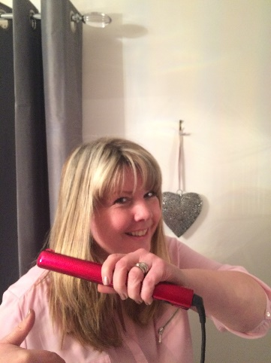
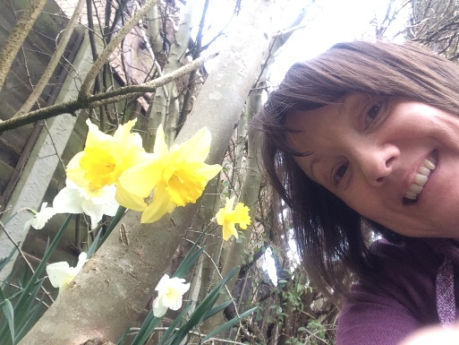
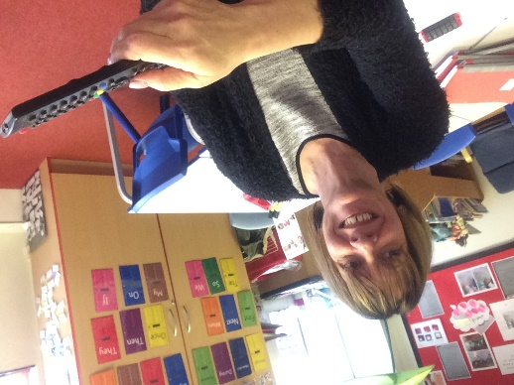
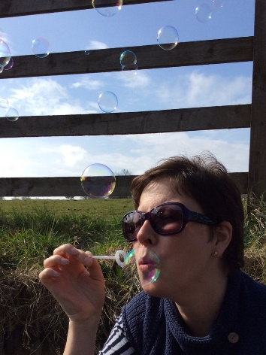
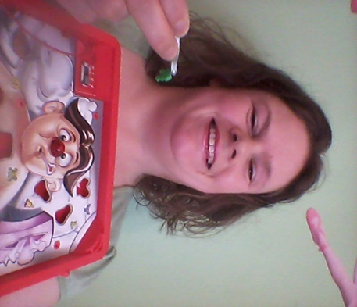
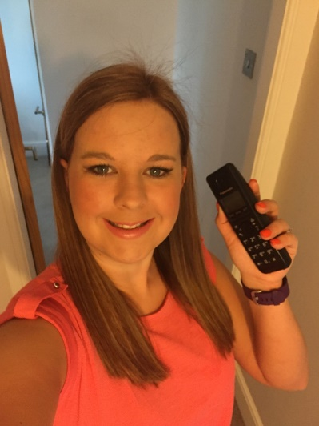
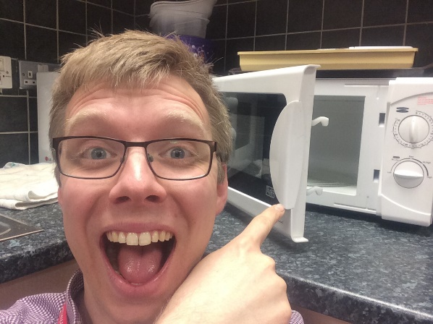
St Peter’s Science Selfie Competition 2016

Slide 2
Science Selfie
For a chance to win science goodies just post a selfie of yourself enjoying science outside of school.
Your selfies could include a visit or taking part in a science activity at home. Be as creative as you like and captions can be included if you wish!
Only one entry per person please.

Slide 3
To enter all you need to do is email your selfie with your name and class to Mrs Mews by 9th May 2016
s.mews@stpeters.lancs.sch.uk

Slide 4
There are 4 prizes up for grabs, a prize for the best selfie in EYFS, one for KS1, one for Lower KS2 and one for Upper KS2.

Slide 5
Don’t forget email your photo entries to:
s.mews@stpeters.lancs.sch.uk
Here are some of ours to inspire you!

Slide 6


Slide 7
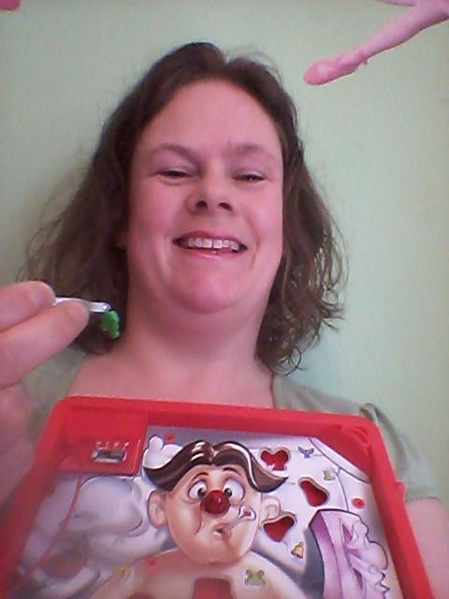

Slide 8


Slide 9


Slide 10


Slide 11
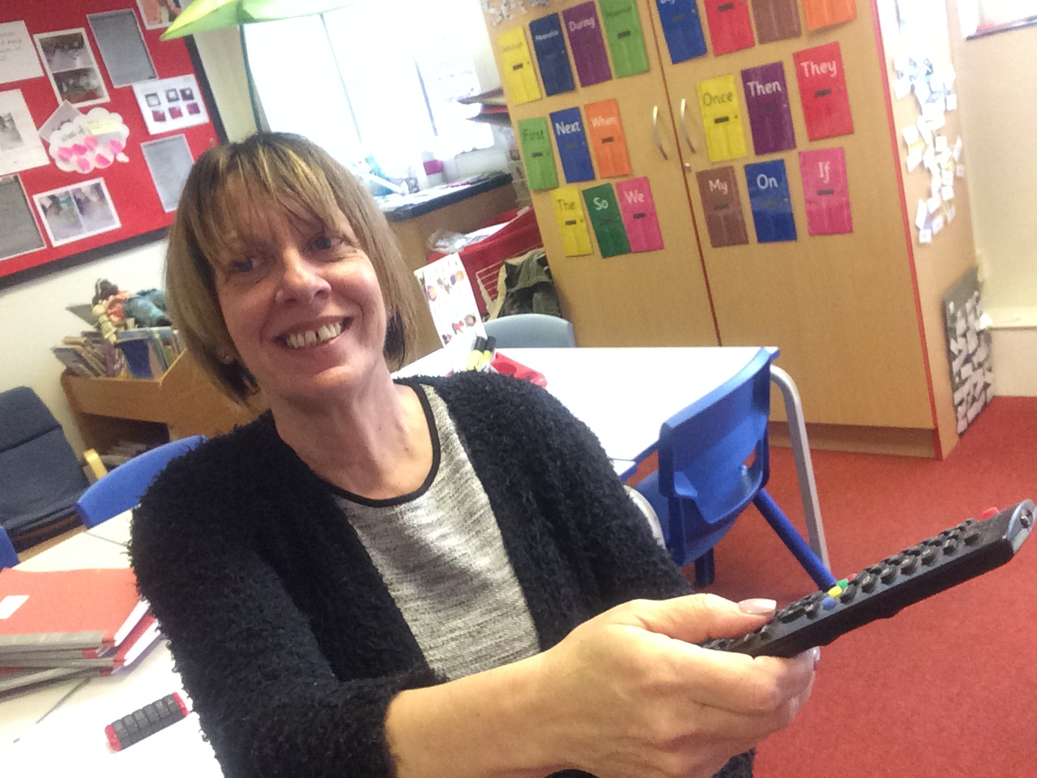

Slide 12


Slide 13
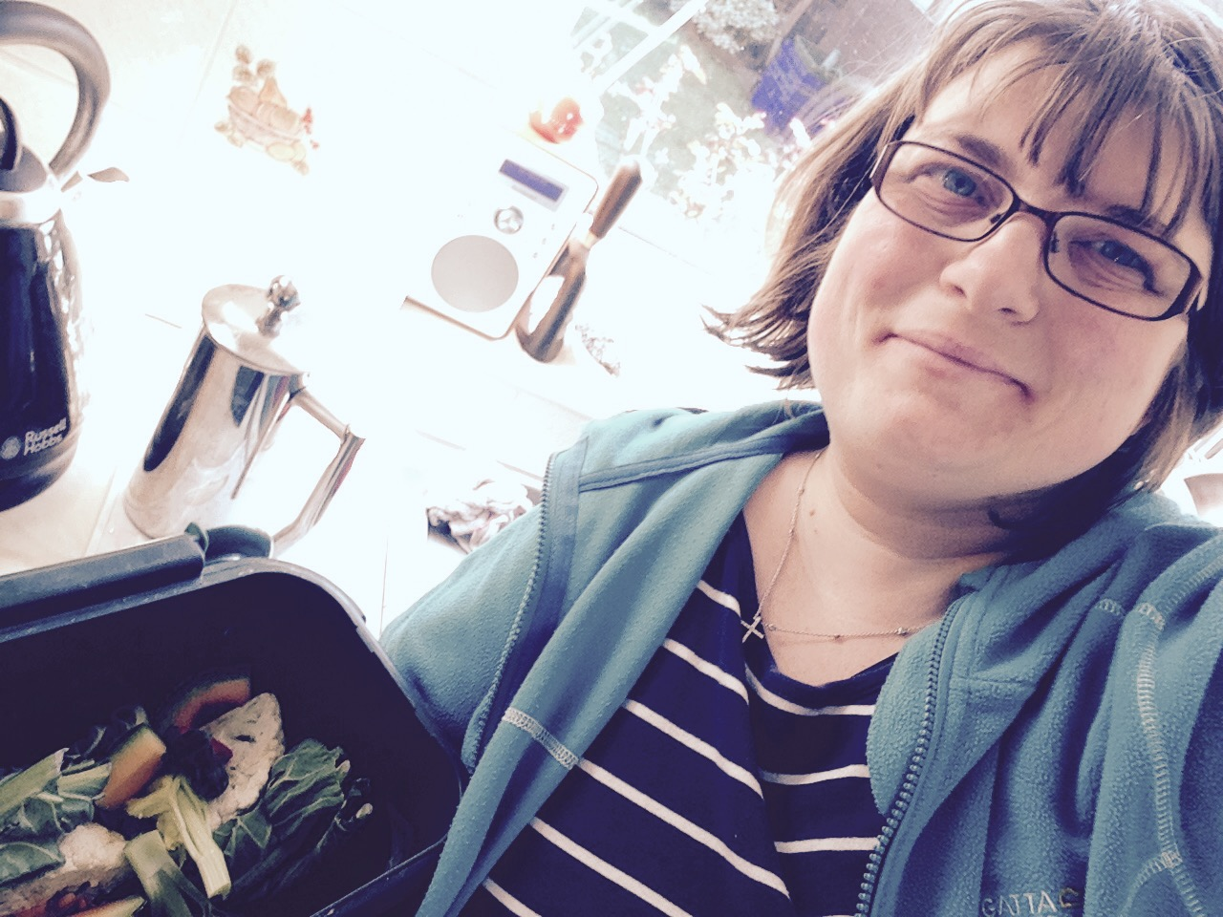

Slide 14
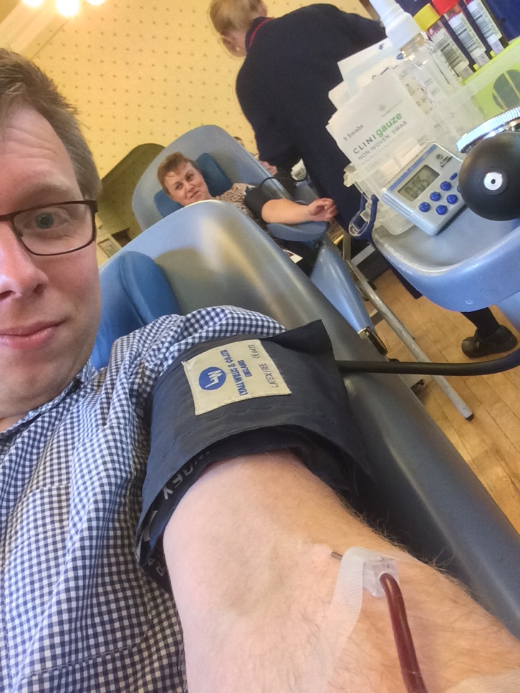

Slide 15
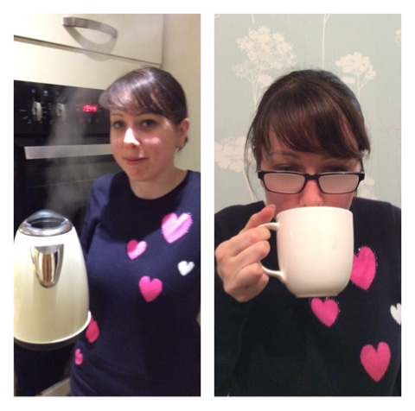

Slide 16
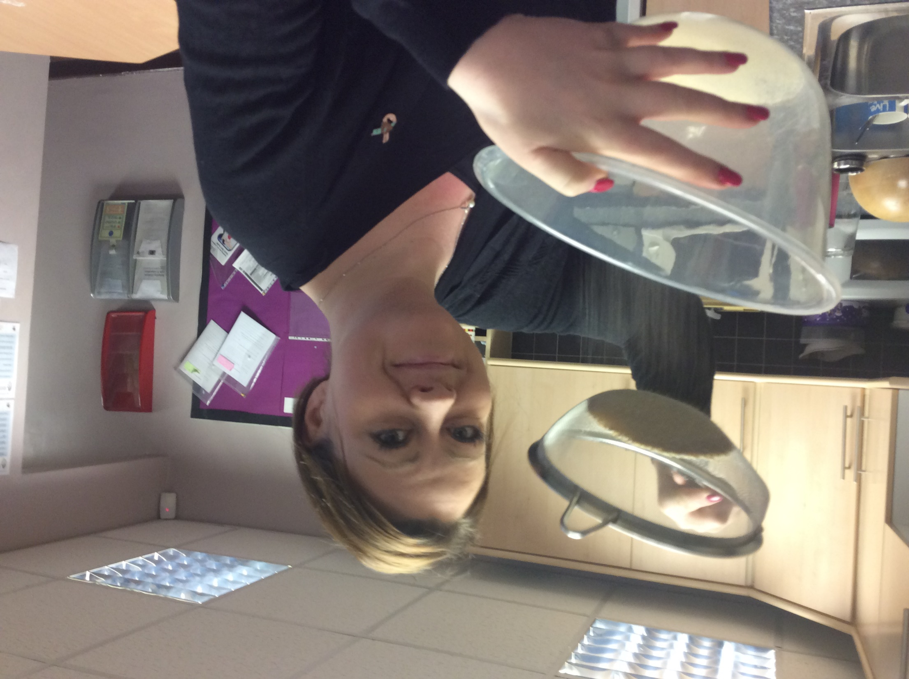

Slide 17
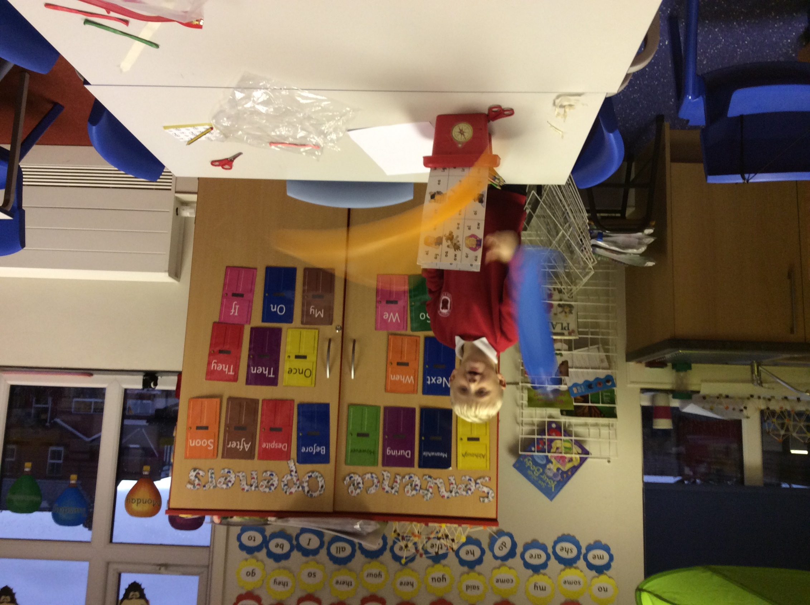

Slide 18
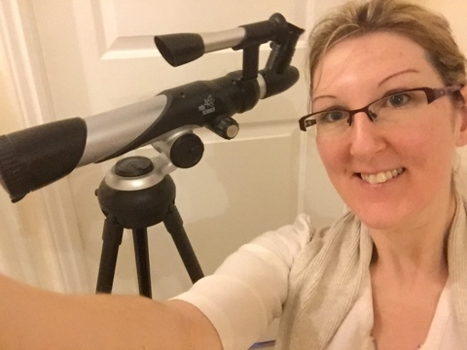

Slide 19
Don’t forget email your photo entries to:
s.mews@stpeters.lancs.sch.uk

