Slide 1
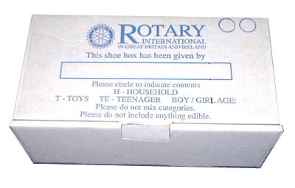
Rotary Shoe Box Appeal

Slide 2
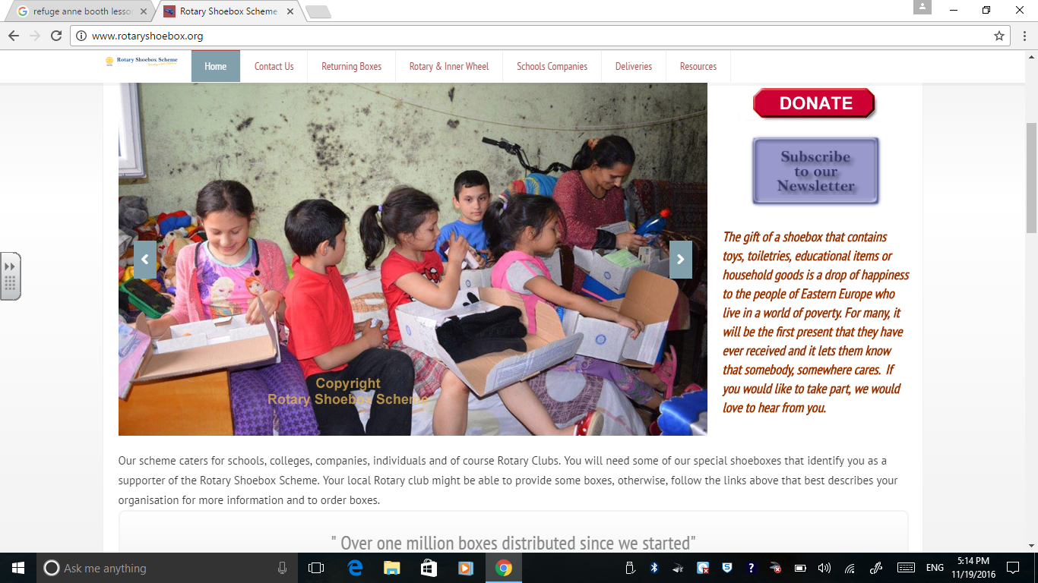
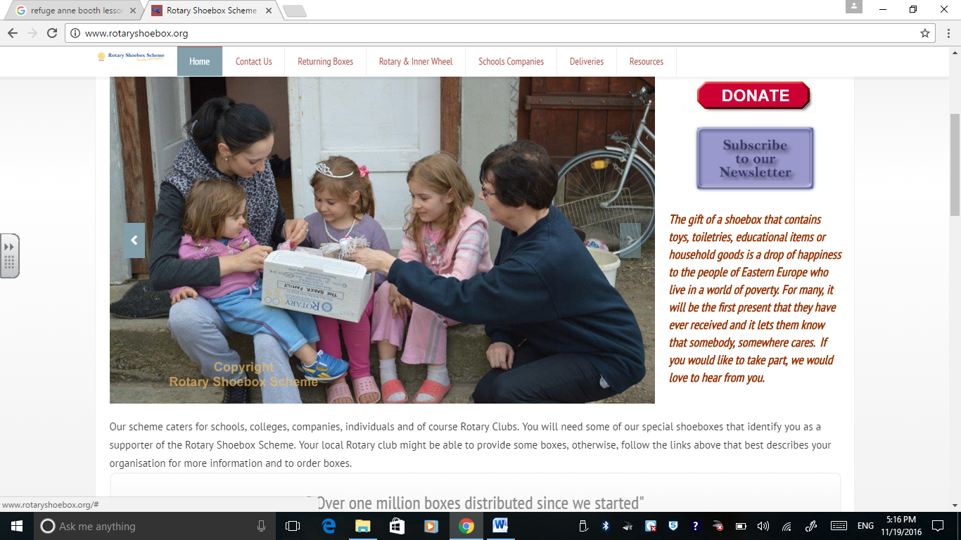
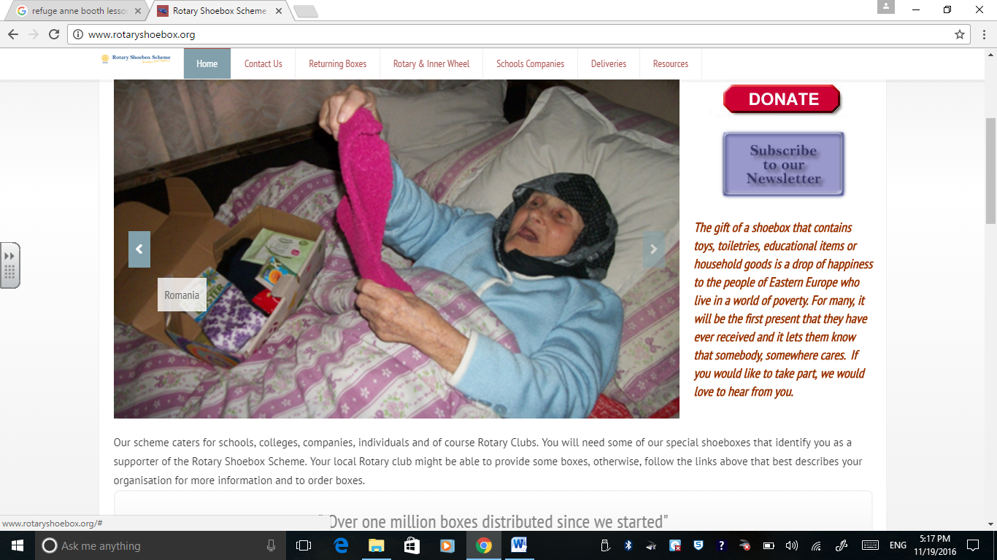
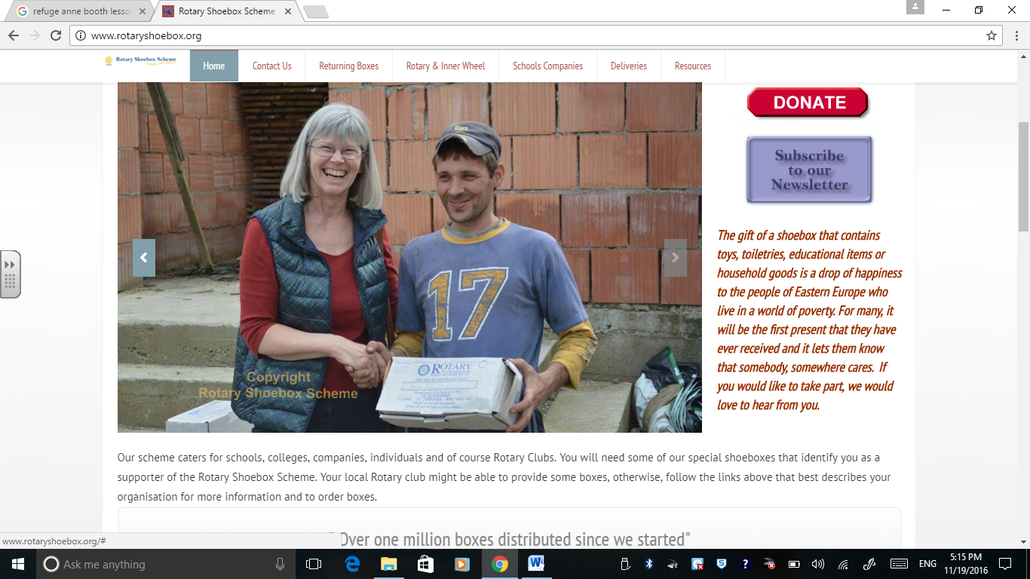
Hope

Slide 3
We are going to give hope to people in Central and Eastern Europe.
Each class is going to try and fill two shoe boxes.
There are 4 categories: Toys, Teenagers, Household Goods and Babies.

